Slide 1


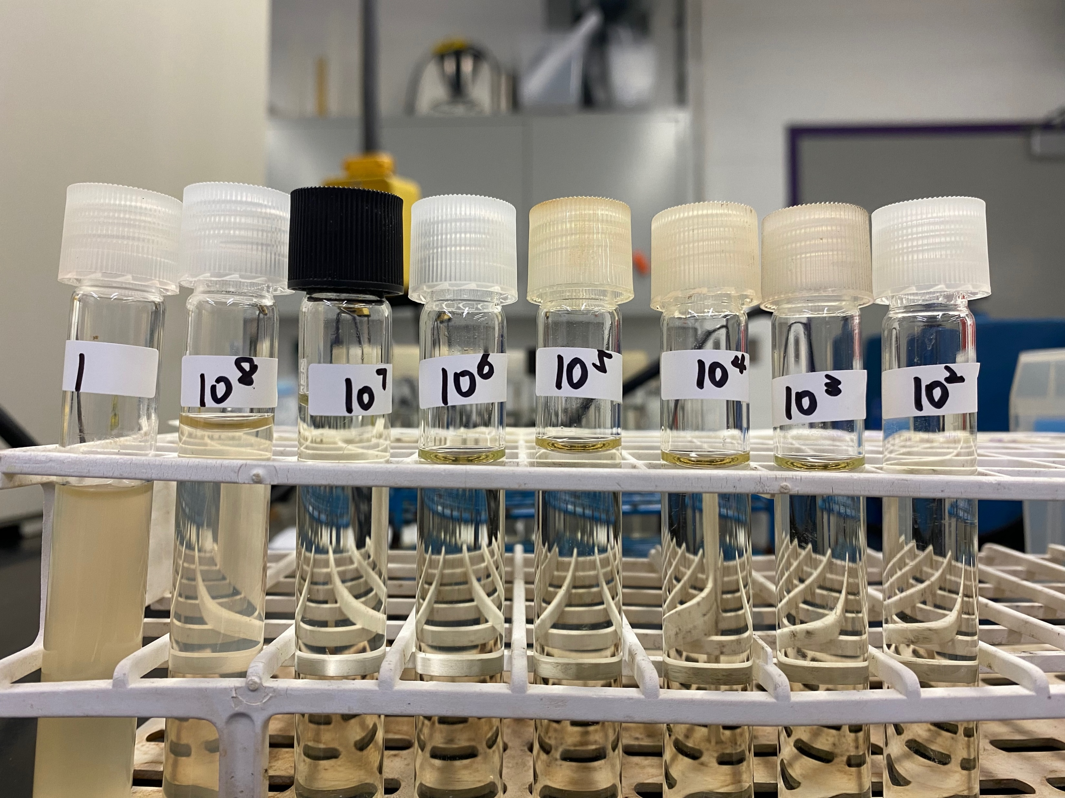

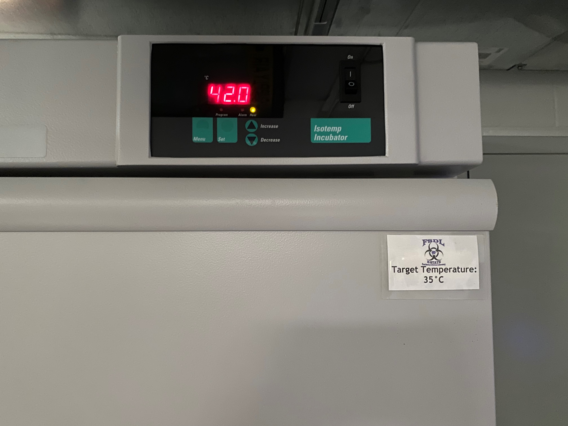
Salmonella Quantification (SalQuant™) Utilizing the BAX® System for
Pork Primary Production Boot Covers Samples
Jimeng Bai¹, Sara E. Gragg¹, Erin Fashenpour¹, Tyler P. Stephens², Savannah F. Applegate²
¹Kansas State University, Department of Animal Sciences and Industry, 1530 Mid-Campus Drive North, Manhattan, KS 66506
²Hygiena™, 2 Boulden Circle, New Castle, DE 19720
Introduction
Results
Although there have been fewer reported outbreaks of food-borne disease associated with pork than with other meat products, the fact that pork may be a source of Salmonella infection in humans cannot be ignored. Salmonella is a natural inhabitant of the swine gastrointestinal tract and can be found in the environment of swine farms. Personnel involved in the rearing of swine routinely wear boot covers, which can be used for quantifying the Salmonella in a swine herd.
Incubating the boot cover samples for 8 hours at 42 º C resulted in a linear fit equation with an R² of 0.91 and a log RMSE of 0.46, which was the best linear fit equation produced by the three incubation times investigated. A statistical difference was not observed (P = 0.6031) for the MPN and SalQuant methods.
Figure 1 (right): Salmonella concentration recovered from inoculated pork boot covers by MPN (MPN/mL) and SalQuant (CFU/mL) methods when inoculated with 0 – 4 CFU/mL of Salmonella Typhimurium. MPN and SalQuant methods were not significantly different at any of the tested inoculation concentrations (P=0.6031).
Error bars indicate 95% confidence interval.
Objectives
This study was conducted to develop and validate the BAX System SalQuant method as a rapid PCR quantification for Salmonella in boot cover samples from the pork primary production setting.
Methodology
Conclusions
2. Boot cover samples were homogenized with 100 mL of buffered peptone water (BPW) and 1 mL was removed, incubated at 42 º C for 18-24 h, and then screened for naturally occurring Salmonella using the BAX system.
The linear of 8 hours of timepoint fit the range which R² = 0.91, Log RMSE=0.46. According to the results of this experiment, after hours of incubation, the BAX System SalQuant method can accurately quantify Salmonella in enriched boot cover slurry.
Significance
1. Boot shoe covers were worn in a pork primary production environment and used as samples to represent typical background flora and debris.
BAX System SalQuant can accurately quantify Salmonella from pork primary production boot covers after an 8-hour incubation at 42 ˚C. This provides the pork industry with a rapid approach to quantifying Salmonella populations in the primary pork production environment.
3. Negative boot cover samples were inoculated with Salmonella Typhimurium (ATCC 14028) at concentrations of 0.00 – 4.00 Log CFU/mL.
Reference
5. A 3×5 MPN analysis was conducted for Negative, 0.0, 1.0 log samples, while a 3×3 MPN for 2.0, 3.0, 4.0 log samples. Incubated MPN 24 h at 37 °C. Run BAX System assay after incubated.
6. SalQuant timepoints were analyzed using JMP® v. 15 to calculate RMSE and determine the timepoint most effective for enumerating Salmonella in pork production boot covers. SalQuant and MPN were compared at each inoculation concentration with a paired t-test using GraphPad Prism 9.0.
Salmonella as a foodborne pathogen in pork. (n.d.). Retrieved June 9, 2022, from https://projects.ncsu.edu/project/swine_extension/publications/factsheets/816s.htm
4. 30 mL of samples were enriched with 30 mL of BAX MP + Quant Solution for 6, 8, 10h at 42 °C and quantified using the BAX System RT Assay for Salmonella.
Acknowledgements
This project was funded and supported by Hygiena. The authors thank Macie Reeb of Kansas State University for her assistance with boot cover sample collection.

