Slide 1
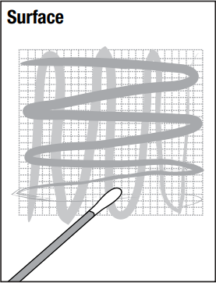
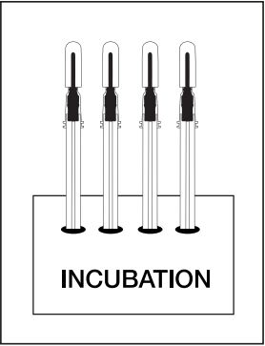
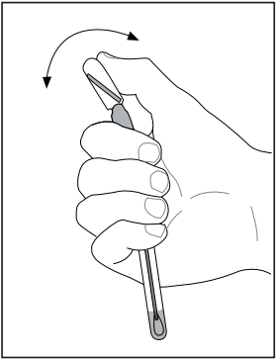
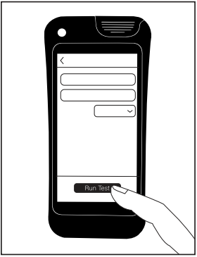
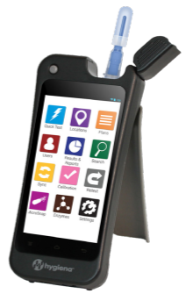
Detection and Enumeration of Enterobacteriaceae Organisms from Various Surfaces using Hygiena’s MicroSnap® SX-EB (Surface Xpress™ for Enterobacteriaceae) and Comparison to the ISO 21528-2:2017 Method
Title/Headline: 105 pt. Arial Bold, Tight Character Spacing, Line Spacing-Exactly – 105 pt.
Jack Garretty, Mat Lovesmith, and Paul Meighan,
Hygiena® International Ltd, Frederick Sanger Road, Guildford, Surrey United Kingdom
INTRODUCTION:
Many foodborne illnesses originate from contamination of uncleaned environmental surfaces and manufacturing equipment. The Enterobacteriaceae family of gram-negative organisms is often used as an indicator of fecal contamination and contains a number of harmful bacterial species. The MicroSnap® SX-EB (Surface Xpress™ for Enterobacteriaceae) is a self-contained rapid bioluminescent test for the detection and enumeration of Enterobacteriaceae from an environmental surface, providing results in 4-5 hours.
Methods
Results
System
Stainless-steel, concrete, plastic, ceramic, and rubber coupons (100 cm²) were inoculated with E. aerogenes/S. aureus (as a non-target competitor), C. freundii, S. Abaetetuba, C. malonaticus, and E. coli, respectively, at four different CFU levels and then allowed to dry for 18-24 h. After drying, the samples were collected from the surfaces using MicroSnap SX-EB and following ISO 18593 - Microbiology of the food chain — Horizontal methods for surface sampling (2). The devices were incubated at 37 °C and tested at 4 and 5 hours, respectively. The ISO 21528-2:2017 method was run alongside this validation as an unpaired study to determine the recovered CFU levels from the surfaces post-drying.
The CFU readings from MicroSnap SX-EB devices were collected at 4 h and 5 h, respectively, and compared with the ISO 21528-2:2017 results to determine equivalency.
The 4- and 5-hour results showed that among the four different spike levels (10-100, 100-1000, 1000-10000, & 0 CFUs), the difference of means between the two methods were within a half log of each other, demonstrating very similar CFU counts from both methods.
MicroSnap SX-EB contains bioluminescent reagents in which biomarkers produced by bacteria are measured using a small portable luminometer. The simple procedure requires a short incubation period using Hygiena® dry block incubators set to 37 °C, facilitating the growth of bacteria, followed by a detection step. During incubation in enrichment media, bacteria numbers increase, and potential sample interference is reduced. As bacteria grow, they use up available food resources in the media and generate biomarkers. The greater the number of bacteria in the sample, the higher the biomarker concentration. After the enrichment phase is complete, the device is activated, mixed, and measured using an EnSURE® Touch luminometer. The light output is directly proportional to the concentration of biomarkers from the bacteria. The EnSURE Touch luminometer is synced to a SureTrend® software account which means the CFU results are automatically uploaded into an easy-to-navigate database, with features allowing data analysis, trend analysis and insight generation.
Matrix Testing Study Results
Silicone Rubber
Ceramic
Stainless Steel
Incubation time | Contamination level | MS-SX EB Result | ISO 21528-2 results | DOM | 90% CI
 |  | Mean | Mean |  | LCL | UCL
4hr | Level 4 | 3.89 | 4.30 | -0.41 | -0.64 | -0.17
 | Level 3 | 3.27 | 3.75 | -0.48 | -0.61 | -0.25
 | Level 2 | 2.16 | 2.14 | 0.02 | -0.18 | 0.22
 | Level 1 | 1.15 | 1.39 | -0.24 | -0.58 | 0.10
 | Blank | -0.19 | -0.58 | 0.39 | -0.97 | 1.75
5hr | Level 4 | 3.27 | 2.99 | 0.28 | -0.45 | 0.82
 | Level 3 | 3.00 | 3.19 | -0.19 | -0.47 | 0.10
 | Level 2 | 2.61 | 2.30 | 0.31 | 0.24 | 0.38
 | Level 1 | 1.92 | 1.67 | 0.25 | -0.04 | 0.54
 | Blank | 0.40 | 0.12 | 0.28 | -0.20 | 0.75
Incubation time | Contamination level | MS-SX EB Result | ISO 21528-2 results | DOM | 90% CI
 |  | Mean | Mean |  | LCL | UCL
4hr | Level 4 | 3.25 | 3.29 | 0.04 | -0.34 | 0.41
 | Level 3 | 2.16 | 2.21 | 0.05 | -0.23 | 0.32
 | Level 2 | 2.30 | 1.81 | -0.49 | -0.85 | -0.13
 | Level 1 | 1.53 | 1.53 | 0.00 | -0.27 | 0.27
 | Blank | 0.83 | 0.86 | 0.03 | -0.20 | 0.26
5hr | Level 4 | 3.66 | 3.34 | -0.32 | -0.45 | -0.20
 | Level 3 | 3.28 | 2.97 | -0.31 | -0.71 | -0.09
 | Level 2 | 2.34 | 1.89 | -0.45 | -0.57 | -0.03
 | Level 1 | 1.50 | 1.59 | 0.09 | -0.06 | 0.24
 | Blank | 0.74 | 0.44 | -0.31 | -0.70 | 0.09
Incubation time | Contamination level | MS-SX EB Result | ISO 21528-2 results | DOM | 90% CI
 |  | Mean | Mean |  | LCL | UCL
4hr | Level 4 | 3.12 | 3.17 | -0.04 | -0.35 | 0.26
 | Level 3 | 2.84 | 2.78 | 0.06 | -0.19 | 0.32
 | Level 2 | 2.23 | 2.11 | 0.12 | -0.13 | 0.37
 | Level 1 | 1.17 | 1.26 | -0.09 | -0.50 | 0.33
 | Blank | 0.39 | 0.32 | 0.08 | -0.22 | 0.38
5hr | Level 4 | 2.99 | 3.08 | -0.08 | -0.47 | 0.28
 | Level 3 | 3.53 | 3.47 | 0.06 | -0.23 | 0.35
 | Level 2 | 2.61 | 2.65 | -0.03 | -0.27 | 0.21
 | Level 1 | 1.51 | 1.36 | 0.15 | -0.13 | 0.43
 | Blank | 0.53 | 0.09 | 0.43 | 0.25 | 0.62
PURPOSE:
To demonstrate the detection and enumeration of Enterobacteriaceae in less than 6 hours from 5 different surface matrices and compare results with the ISO 21528-2:2017 (1) method in an unpaired study.
Matrix Testing Results
Matrix Results Discussion / Overall Conclusions
Table 1. Matrix testing results for the Silicone Rubber surface. Table 1 shows a comparison between results generated using MicroSnap SX-EB and the ISO 21528-2 reference method.
Table 2. Matrix testing results for the Ceramic surface. Table 2 shows a comparison between results generated using MicroSnap SX-EB and the ISO 21528-2 reference method.
Table 3. Matrix testing results for the Stainless Steel surface. Table 3 shows a comparison between results generated using MicroSnap SX-EB and the ISO 21528-2 reference method.
Significance
Plastic
Sealed Concrete
Incubation time | Contamination level | MS-SX EB Result | ISO 21528-2 results | DOM | 90% CI
 |  | Mean | Mean |  | LCL | UCL
4hr | Level 4 | 3.86 | 3.69 | -0.17 | -0.55 | 0.21
 | Level 3 | 2.71 | 2.77 | 0.06 | -0.09 | 0.21
 | Level 2 | 1.92 | 1.86 | -0.06 | -0.61 | 0.61
 | Level 1 | 0.65 | 0.79 | 0.14 | -0.41 | 0.59
 | Blank | 0.21 | 0.06 | -0.15 | -0.92 | 0.62
5hr | Level 4 | 3.21 | 3.69 | 0.48 | 0.12 | 0.64
 | Level 3 | 2.61 | 2.77 | 0.16 | -0.16 | 0.48
 | Level 2 | 1.97 | 1.86 | -0.11 | -0.60 | 0.38
 | Level 1 | 1.35 | 0.79 | -0.56 | -0.57 | -0.05
 | Blank | 0.26 | 0.06 | -0.20 | -0.72 | -0.54
Incubation time | Contamination level | MS-SX EB Result | ISO 21528-2 results | DOM | 90% CI
 |  | Mean | Mean |  | LCL | UCL
4hr | Level 4 | 3.39 | 3.47 | -0.08 | -0.45 | 0.30
 | Level 3 | 2.38 | 2.72 | -0.34 | -0.69 | 0.01
 | Level 2 | 2.26 | 2.11 | 0.15 | -0.17 | 0.46
 | Level 1 | 1.25 | 1.30 | 0.12 | -0.19 | 0.43
 | Blank | 0.98 | 0.93 | 0.05 | -0.14 | 0.24
5hr | Level 4 | 3.20 | 3.19 | 0.08 | -0.31 | 0.33
 | Level 3 | 2.92 | 3.00 | -0.08 | -0.50 | 0.34
 | Level 2 | 2.53 | 2.62 | -0.09 | -0.32 | 0.12
 | Level 1 | 1.81 | 1.53 | 0.27 | 0.08 | 0.47
 | Blank | 0.82 | 0.35 | 0.47 | 0.22 | 0.72
Contamination Level | CFU Target
Level 4 | 10,000 - 100,000
Level 3 | 1000 - 10,000
Level 2 | 100-1000
Level 1 | 10-100
Blank | 0
The MicroSnap SX-EB can be used as a simple, rapid, and accurate method to measure Enterobacteriaceae from the five different matrices as compared to a traditional method.
References
REGISTERED TRADEMARKS
MicroSnap®, EnSURE® Touch, SureTrend® and Hygiena® are registered trademarks of Hygiena.
Surface Xpress™ is a trademark of Hygiena.
ISO 18593 - Microbiology of the food chain — Horizontal methods for surface sampling.
2) ISO 21528-2 -Microbiology of the food chain — Horizontal method for the detection and enumeration of Enterobacteriaceae —Part 2: Colony-count technique.
Table 4. Matrix testing results for the Plastic surface. Table 4 shows a comparison between results generated using MicroSnap SX-EB and the ISO 21528-2 reference method.
Table 5. Matrix testing results for the Sealed Concrete surface. Table 5 shows a comparison between results generated using MicroSnap SX-EB and the ISO 21528-2 reference method.

