Slide 1

Contract Positions
Notes:
Edit Date & Supplier Name
Edit Contract Category and # - include effective dates.

Slide 2
Contract Summary
Bringing Value to Members

Slide 3


Contract # 133
Bringing Value to Members
Conventional Blades & Scalpels
Dual Source
Non-Optional
Two Tier Pricing – access & committed at 60%
Expires 5/31/2023 – in process of renewal
Contracting Manger – Megan Renfroe
Competitors
  Myco
  Aspen Surgical

Slide 4
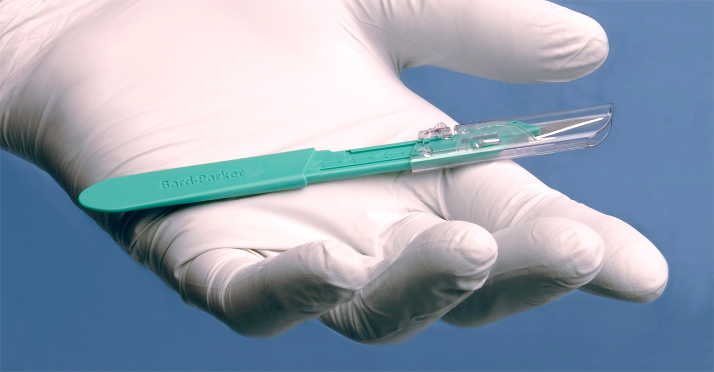
Contract # 199
Bringing Value to Members
Safety Blades & Scalpels
Multi Source
Optional
One Tier Pricing
Expires 5/31/2023 – in process of renewal
Contracting Manger – Megan Renfroe
Competitors
  PenBlade(TIDI)
  DeRoyal/Swan Morten
  Myco & Personna/Self Medic

Slide 5
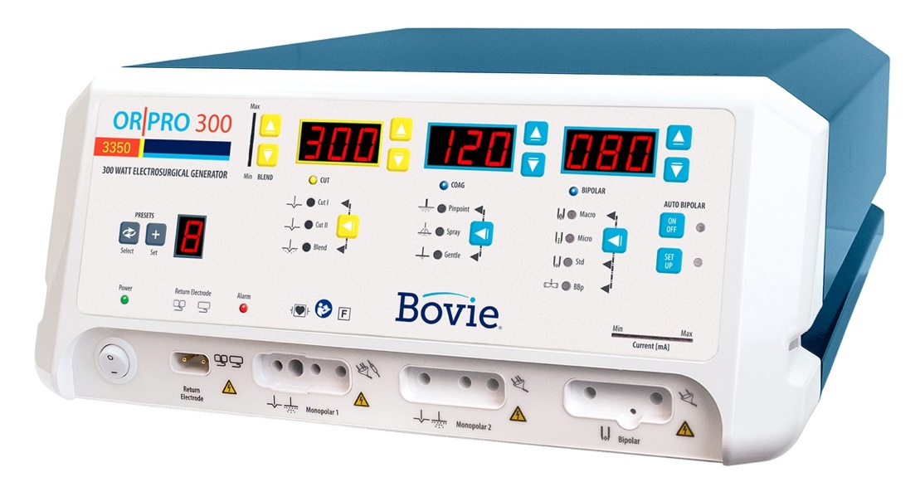
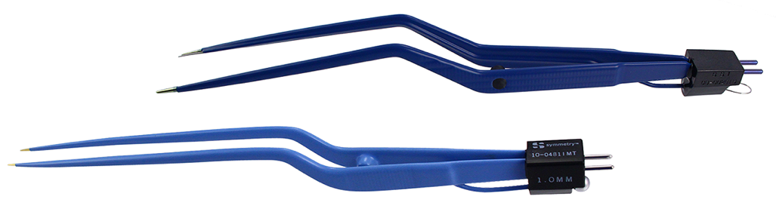
Contract # 42538
Bringing Value to Members
Electrosurgery
Multi Source
Optional
One Tier Pricing
Expires 8/31/2025
Contracting Manger – Mark Nixon
Competitors
  J&J
  Stryker
  Medtronic
  Medline
  Integra

Slide 6
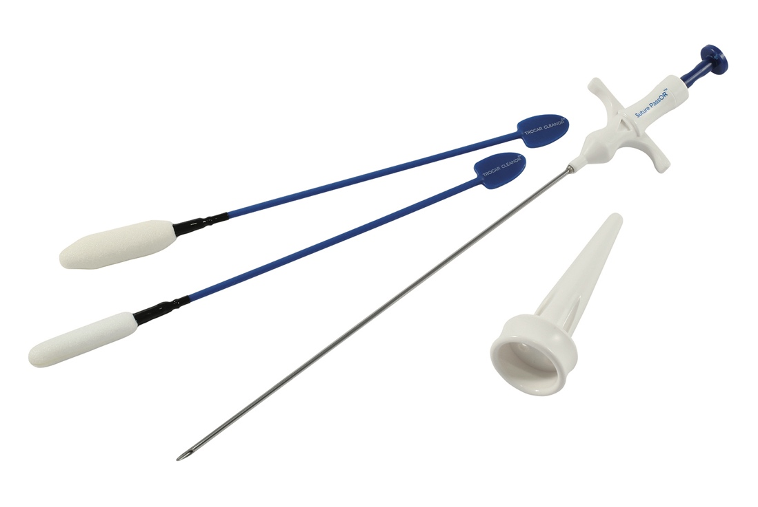
Contract # 37587
Bringing Value to Members
Endo Mechanical/Port Closure
Multi Source
Optional
One Tier Pricing
Expires 10/31/2024
Contracting Manger – Joe Bibelhausen
Competitors
  TeleFlex
  Cooper
  Progressive
  J&J

Slide 7
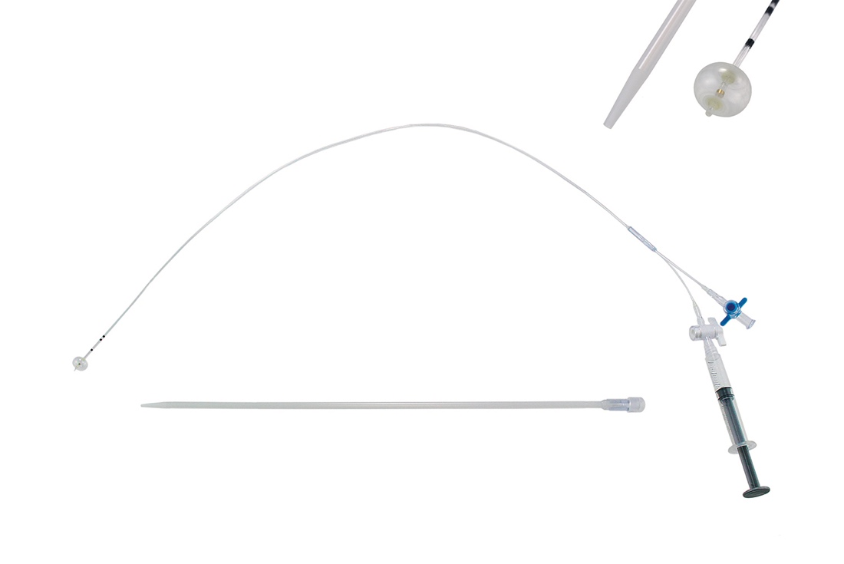
Contract # 37587
Bringing Value to Members
Cholangiogram Catheters
Multi Source
Non-Optional
One Tier Pricing
Expires 4/30/2024
Contracting Manger – Mark Nixon
Competitors
  TeleFlex
  Cook
  Progressive

Slide 8
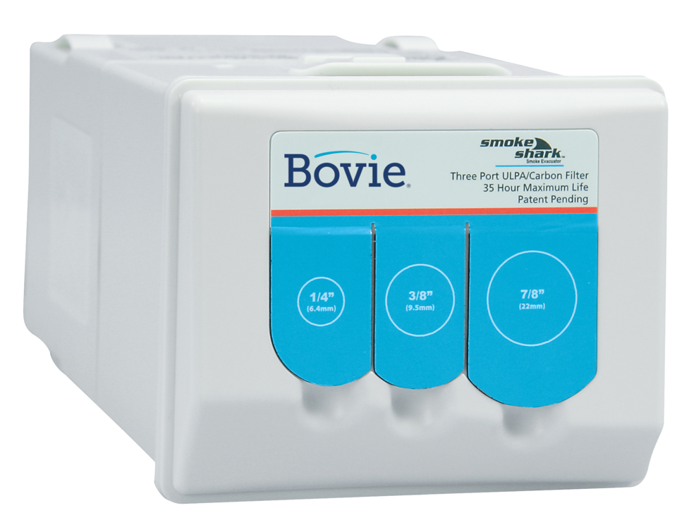
Contract # 42956
Bringing Value to Members
Smoke Evacuation Equipment
Multi Source
Optional
One Tier Pricing
Expires 2/28/2026
Contracting Manger – Mark Nixon
Competitors
  J&J
  Stryker
  Medline
  Medtronic

Slide 9
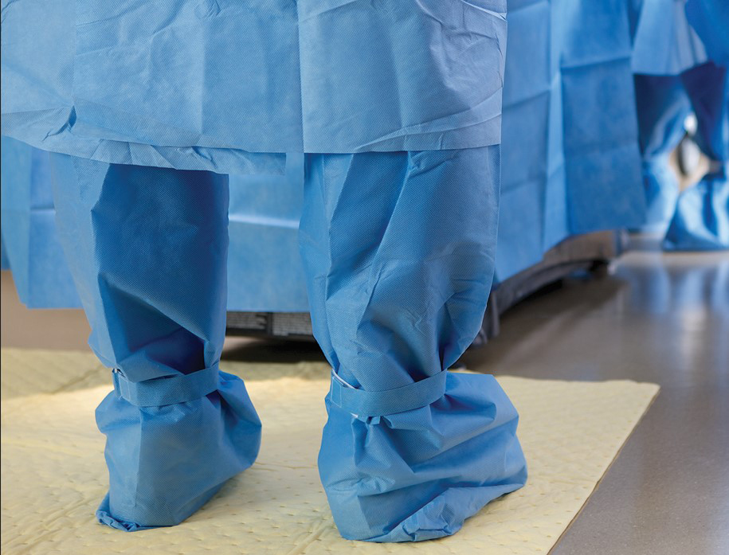
Contract # 5268
Bringing Value to Members
Fluid Management
Multi Source
Optional
One Tier Pricing
Expires 8/31/2024
Contracting Manger – Mark Nixon
Competitors
  Ansell
  Medline

Slide 10
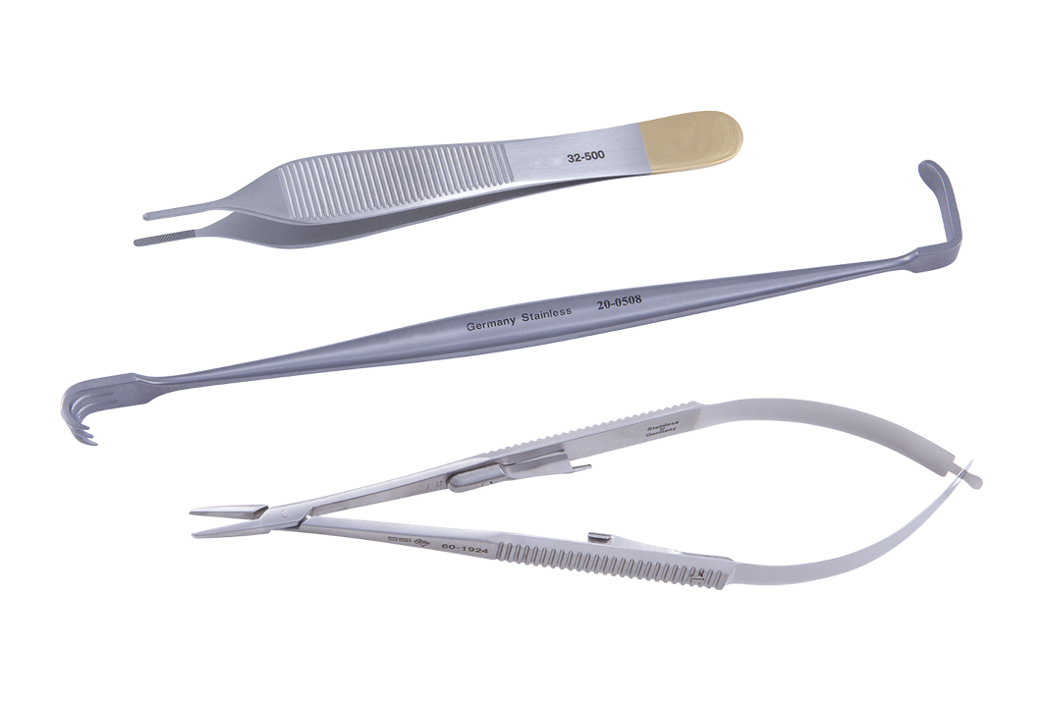

Contract # 72479
Bringing Value to Members
Surgical Products
Multi Source
Optional
One Tier Pricing
Expires 8/31/2024
Contracting Manger – Megan Renfroe
Competitors
  Medline
  Cardinal
  Ansell
  DeRoyal
  Viscot

Slide 11
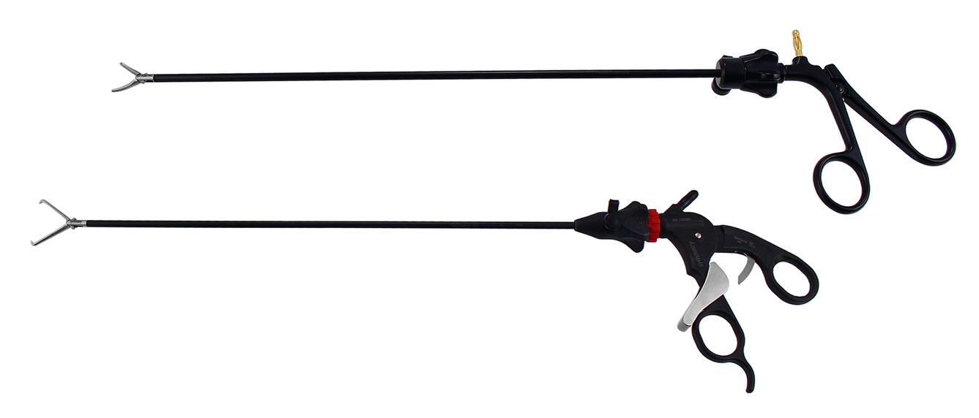
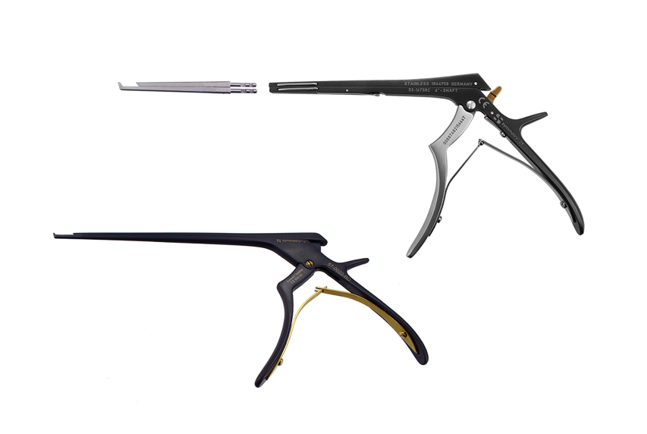
Contract # 293
Bringing Value to Members
Surgical Instruments
Multi Source
Optional
Two Tier Pricing – access and committed
60% compliance
Expires 8/31/2024
Contracting Manger – Megan Renfroe
Competitors
  V-Mullier – BD Care Fusion
  Aesculap
  Integra
  Jarit
  Boss
  Nova Surgical
  Medline

Slide 12
Thank you

