Slide 1
Instrument Business Review
Customer Name
Date

Slide 2
Advancing the Entire Perioperative Experience
Aspen™
Bard-Parker®
Bookwalter®
Bovie®
Olsen®
Precept®
Symmetry®
SURGICAL & MEDICAL ESSENTIALS
SURGICAL INSTRUMENTATION
ELECTROSURGERY
Page 2
©2024 Aspen Surgical Products, Inc ALL RIGHTS RESERVED.

Slide 3

Agenda
Business Updates
Key developments driving our partnership forward
Spend Analysis
Uncover savings and optimize every dollar
Project Updates & Opportunities
Explore what’s in motion and what’s on the horizon
Next Steps
Align on priorities and lock in action items

Slide 4
Your Aspen Surgical Team
3 team members

Slide 5
Business Updates

Slide 6
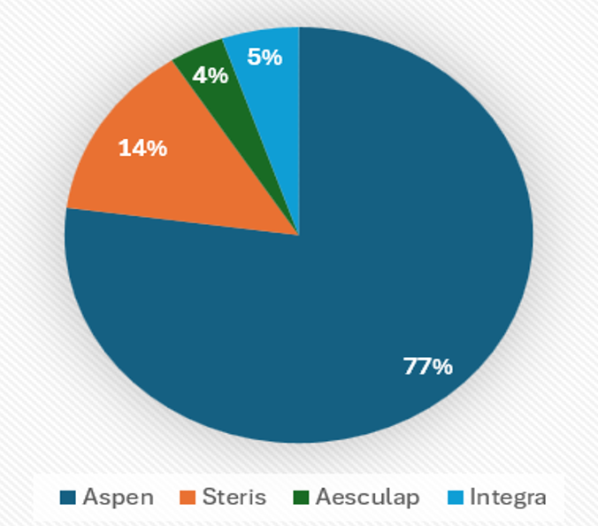
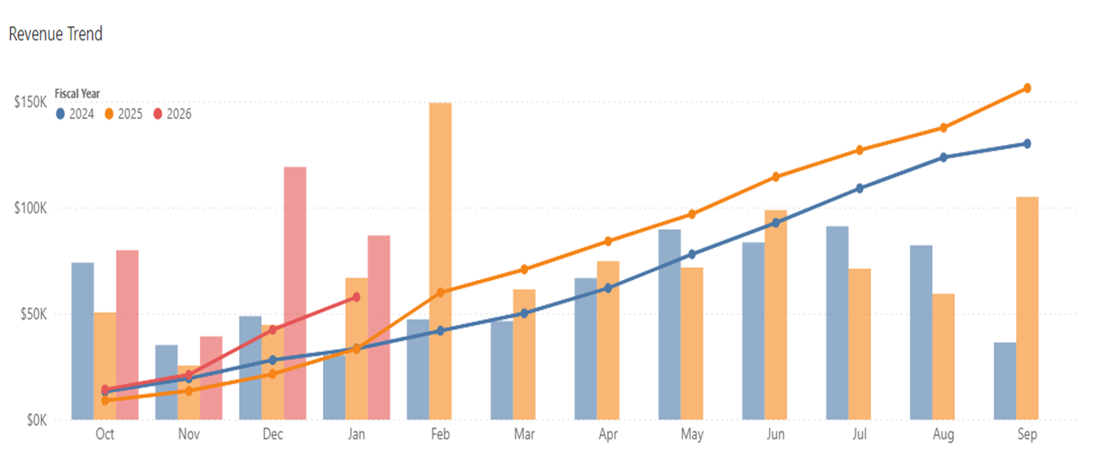
Instrumentation Spend Compliance
By Facility
Hospital A: 91%
Hospital B : 86%
Hospital C : 78% Aspen -- 14% Steris
Hospital D: 75% Aspen -- 23% Steris
Hospital E: 73% Aspen -- 25% Steris
Hospital F: 96%
Optional slide(s) based on data availability – graphs can be created in Excel using customer data
Customer usage file can give you insights into where they are purchasing instruments and their overall spend

Slide 7
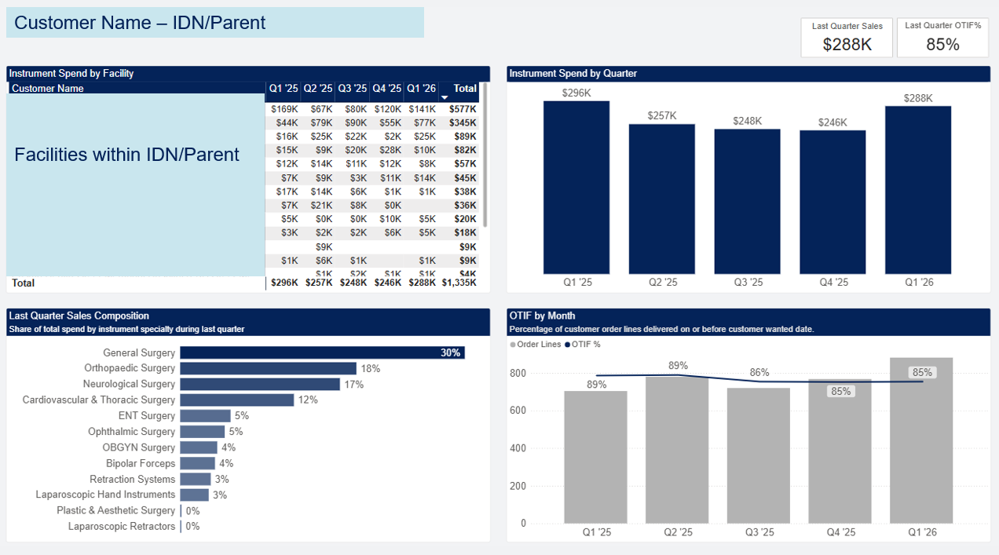
Report is available in PowerBI

Slide 8
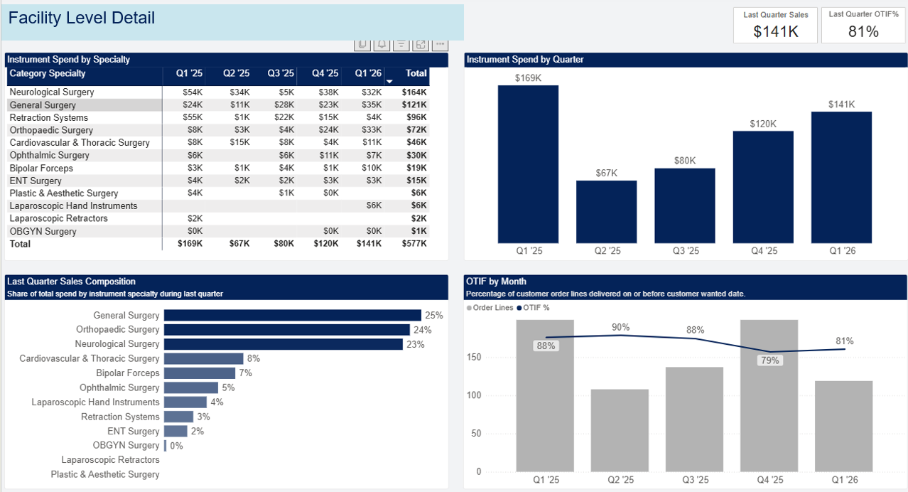
Report is available in PowerBI

Slide 9
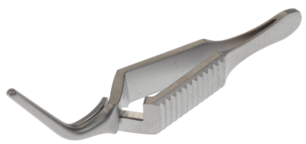
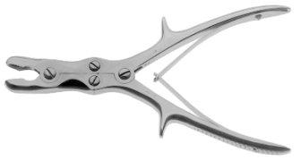
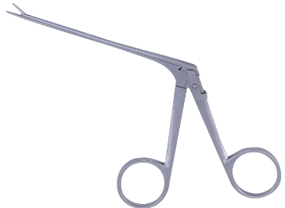
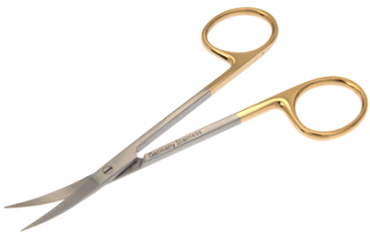
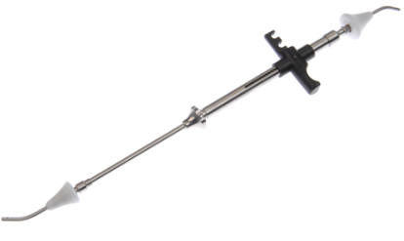
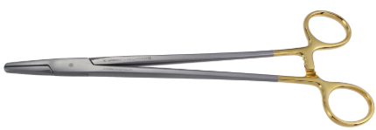
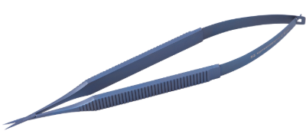


Instrument Portfolio – Use to fill gaps
 | General Surgery | Cardiovascular & Thoracic Surgery | Neurological Surgery | Orthopedic Surgery | ENT Surgery | Ophthalmic Surgery | OBGYN Surgery | Plastic & Aesthetic Surgery | Laparoscopic
Portfolio Categories
Key Brand(s) | Bookwalter® Symmetry™ Classic Plus® | Symmetry™ | Greenberg® Olsen® MicroSet® Symmetry™ Bovie® | Sharp Kerrison® Reveal® Galaxy II® | Symmetry™ Olsen® Bovie® | Symmetry™ | Bookwalter Magrina® Symmetry™ | Symmetry™ Olsen® Bovie® | Symmetry™
Key Items | Forceps Retractors Scissors Needle Holders Suction Tubes Clamps Sounds Knife Handles Probes Dilators | Clamps Forceps Scissors Needle Holders Retractors Dilators Spreaders Shears Rasps Suction Tubes | Curettes Kerrisons Rongeurs Retractors Forceps Elevators Dissectors Scissors Suctions Tubes Hooks | Osteotomes Curettes Retractors Rongeurs Forceps Gouges Elevators Chisels Pliers Cutters | Forceps Specula Scissors Curettes Retractors Knives Elevators Hooks Osteotomes Rasps | Scissors Forceps Needle Holders Hooks Cannulas Specula Probes Retractors Spatulas Rings | Forceps Dilators Curettes Retractors Specula Clamps Scissors Sounds Cannulas Hooks | Scissors Retractors Forceps Cookie Cutters Osteotomes Dissectors Hooks Needle Holders Elevators Clamps | Scissors Dissectors Graspers Probes Coagulators Spoons Retractors Clamps Needle Holders Knot pushers

Slide 10
Project Updates

Slide 11
Next Steps

Slide 12
Thank you!

Slide 13
SPD360™ Key Benefits
Optimized Trays
Efficient
On-time procedures and improved procedural throughput
Back Stock Inventory & Organization
Reduction of assembly time and missing instruments*
Instrument Monitoring
Cost-saving
Appropriate stock supply and budget management
Par Level Visibility
Efficient tray preparation & reduced backorders
Improved Education / Training
Compliance
Improved staff readiness, efficiency and compliance
Improved Valuation of Instrumentation
Efficient instrument inventory lifecycle
*35% reduction of missing instruments & 29% assembly time reduction

