Slide 1
Instrument
Prime Vendor Program
Your Trusted Partner for Surgical Instrument Excellence

Slide 2

Agenda
Aspen Surgical Overview
Our brands, capabilities, and global footprint
Instrument Portfolio
Coverage across surgical specialties with trusted brands
Prime Vendor Partnership
Consolidate, simplify, and maximize value
Add-on Services
SPD360™ Solutions offering
Getting Started
Next steps to build our partnership

Slide 3
Your Aspen Surgical Team
3 team members

Slide 4
Your Aspen Surgical Team
6 team members

Slide 5
Advancing the Entire Perioperative Experience
Aspen™
Bard-Parker®
Bookwalter®
Bovie®
Olsen®
Precept®
Symmetry®
SURGICAL & MEDICAL ESSENTIALS
SURGICAL INSTRUMENTATION
ELECTROSURGERY
Page 5
©2024 Aspen Surgical Products, Inc ALL RIGHTS RESERVED.

Slide 6
Who We Are
Who We Are
Our Purpose
A trusted provider of surgical essentials offering a unique combination of portfolio scale and partnership flexibility, committed to delivering quality and consistency. Our portfolio spans the entire patient perioperative journey, from single-use essentials to sophisticated equipment, enabling clinical excellence.
To provide clinicians with the tools to advance the entire perioperative patient journey.
Our Mission
We earn trust across the procedures of today and tomorrow by delivering a broad portfolio and creating clinical, economic, and relationship value.
~$475M
1400⁺
7
5
Revenue
Employees
Trusted Brands
Manufacturing Sites
Page 6
©2026 Aspen Surgical Products, Inc ALL RIGHTS RESERVED.

Slide 7
Industry-leading Surgical Solutions
Global footprint with North American manufacturing
Multi-channel Capabilities
Manufacturing
Jamaica,
New York
Corporate, Manufacturing,
& Distribution
Caledonia,
Michigan (HQ)
Manufacturing
Tuttlingen,
Germany
Acute Care
ASC
Physician office
GPO & IDN partnerships
Commercial
& Distribution
Melbourne,
Australia
Distributors & Kit Packers
Manufacturing
Las Piedras,
Puerto Rico
Manufacturing & Distribution
Agua Prieta,
Mexico

Slide 8
Trusted brands that support all surgical specialties since 1838
Instrument Portfolio

Slide 9
About Aspen Surgical Instrumentation
History and portfolio
A Legacy of Instrument Craftmanship
Our instrumentation heritage dates to 1838, when Thomas Codman founded the Codman surgical instrument business. It has evolved into a comprehensive portfolio spanning every specialty and site of care.
Key Instrumentation Brands
Symmetry™ | Bovie® | Bookwalter® Olsen® | Greenberg® | Sharp Kerrison® | Classic Plus® | Reveal® MicroSet® | Galaxy II® | Cygnus®
Supply Chain Transparency & Accountability
Real-time product availability, cross-referencing and customer-contracted pricing on our website for seamless procurement.

Slide 10



Symmetry Instruments History
Symmetry™, Olsen®, Bovie®, The OR Company™
Aspen Surgical
Establishment of Core Brands
2007
Symmetry Acquisitions
2018
Oct ‘22
Aspen Surgical completes
transformational acquisition
of Symmetry
1838
1880
1976
2007
2011
2012
2018
2018
Surgical
Instruments
Electro-Surgical
Surgical
Instruments
Electro-Surgical
MIS Surgical

Slide 11
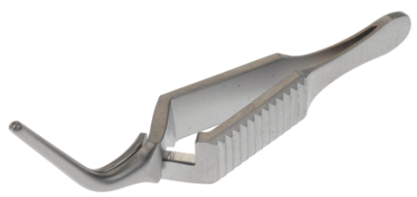
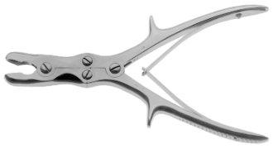
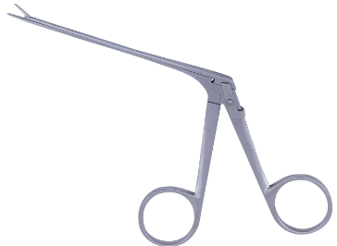
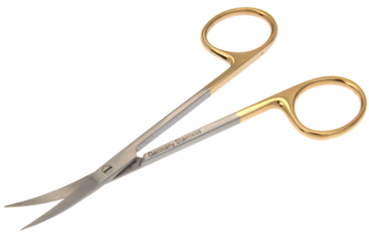
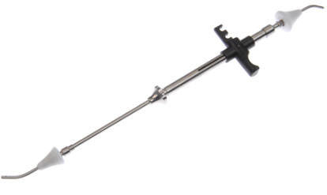
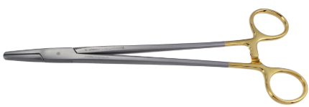
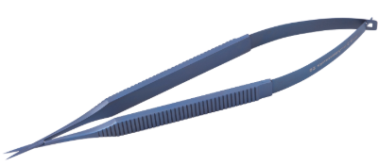


Instrument Portfolio
 | General Surgery | Cardiovascular & Thoracic Surgery | Neurological Surgery | Orthopedic Surgery | ENT Surgery | Ophthalmic Surgery | OBGYN Surgery | Plastic & Aesthetic Surgery | Laparoscopic
Portfolio Categories
Key Brand(s) | Bookwalter® Symmetry™ Classic Plus® | Symmetry™ | Greenberg® Olsen® MicroSet® Symmetry™ Bovie® | Sharp Kerrison® Reveal® Galaxy II® | Symmetry™ Olsen® Bovie® | Symmetry™ | Bookwalter Magrina® Symmetry™ | Symmetry™ Olsen® Bovie® | Symmetry™
Key Items | Forceps Retractors Scissors Needle Holders Suction Tubes Clamps Sounds Knife Handles Probes Dilators | Clamps Forceps Scissors Needle Holders Retractors Dilators Spreaders Shears Rasps Suction Tubes | Curettes Kerrisons Rongeurs Retractors Forceps Elevators Dissectors Scissors Suctions Tubes Hooks | Osteotomes Curettes Retractors Rongeurs Forceps Gouges Elevators Chisels Pliers Cutters | Forceps Specula Scissors Curettes Retractors Knives Elevators Hooks Osteotomes Rasps | Scissors Forceps Needle Holders Hooks Cannulas Specula Probes Retractors Spatulas Rings | Forceps Dilators Curettes Retractors Specula Clamps Scissors Sounds Cannulas Hooks | Scissors Retractors Forceps Cookie Cutters Osteotomes Dissectors Hooks Needle Holders Elevators Clamps | Scissors Dissectors Graspers Probes Coagulators Spoons Retractors Clamps Needle Holders Knot pushers

Slide 12
Tailored to your facility's size, needs, and goals
Prime Vendor Partnership

Slide 13
Benefits of a Prime Vendor Partnership
Instrument Vendor Conversion Support
SPD360™ In-person Evaluations
Implementation planning and management assistance; count sheet, ERP and tracking system updates
Customized analysis of backstock inventory organization, workflows and count sheet data
Instrument Backwall Standardization
Standing On-Site Visits
Organization, identification labeling of backstock inventory
Regular visit cadence from Aspen account team
Instrument Business Reviews
24/7 eCommerce Portal
Instrument spend insights, compliance analysis
Self-service ordering, quotes, order history, and real-time order tracking

Slide 14
Additional options that can be used on slide 14 –
Items in red box must meet customer requirements for each item – refer to the PV Playbook for details and work with your RD for approval.
Green box items below can be used as needed, no approval needed
Short-term Onsite Support
Implementation/integration specialist(s) onsite at your facility to assist with integration for a specific length of time
Routine Retraction System Quality Inspections
Ensures your retractors are in optimal working condition
Full-time Dedicated Onsite Support
Implementation/integration specialist onsite at your facility
Online Continuing Education Courses
5 course offerings providing a total of 7 hours of CE credit
Priority Order Fulfillment
Order fulfillment priority in our ERP system
Dedicated Customer Service Support Line
Access to a dedicated support team phone number
Custom Reporting and Analytics
Specialized reports by request i.e. On-Time In-Full (OTIF), Spend by Catalog, etc.

Slide 15
The Impact of Partnership
Current State
Prime Vendor Partnership Delivers
Multiple instrument vendors to manage
Inconsistent pricing across suppliers
Fragmented ordering and invoicing
Limited visibility into total spend
Reactive, transactional relationships
Consolidated instrument procurement with a trusted GPO vendor
Contracted pricing across a comprehensive product offering
Streamlined ordering, invoicing, and inventory management
  24/7 real time order history/tracking via eCommerce portal
Spend & order fulfillment analytics via Quarterly Instrument Business Reviews (IBR)
Dedicated, proactive account management team
  Standing on-site visits tailored to your facility’s needs
  Vendor conversion implementation support: cross-referencing, count sheet updates, and tracking system integration

Slide 16
Instrument Vendor Conversion Support
Onsite support will assist in the development of a conversion plan and execution of the actions required to successfully implement a preferred vendor partnership
The phased approach will define the process and activities, assign responsible parties, and establish clear timelines and due dates.
Phase 1
Goal Setting & Data Collection/Analysis
Phase 2
Contract & Implement
Phase 3
Sample Evaluations
Phase 4
Post Conversion Reporting

Slide 17
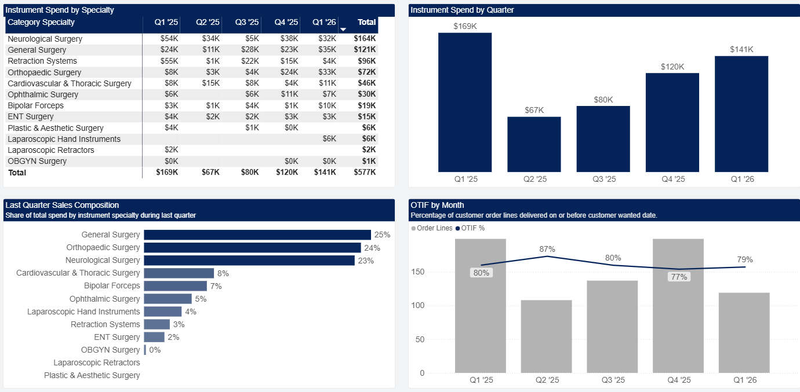
Instrument Business Review – Path to Compliance

Slide 18

eCommerce &
Self-Service Portal
24/7 access to the tools and
information your team needs
Contract-aligned pricing
Instant quote generation
Order history access
Real-time shipment tracking
Detailed invoice access for streamlined AP workflows
Competitive part number cross-referencing
Supply chain transparency with stocking status and lead-times
24/7 self-service purchasing

Slide 19
Prime Vendor Pricing
Delete or update based on your pricing strategy
Moving GPO Tiers
  Estimated cost savings
Growth rebates
Non-contracted instruments local pricing discounts

Slide 20
SPD360™
Add-on Solutions

Slide 21
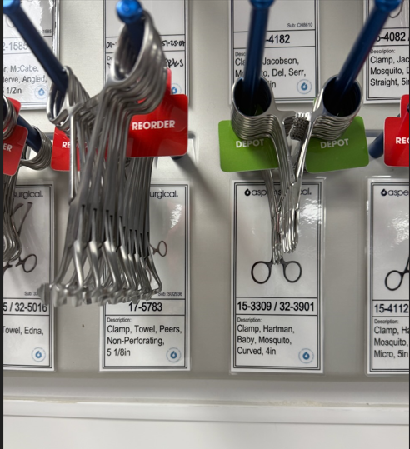


Aspen Surgical SPD360™ Solutions
SPD360™ Solutions
SPD360™ Sync
SPD360™ Support
Optimization services provided to inventory, organize, update, & standardize instrument stock & data.
Count Sheet Data Cleanse – Update, correct, and standardize data and nomenclature.
Set Standardization – Standardization of instrument & vendor across set lists.
    Inventory Optimization – Backstock instrument inventory clean-up and organization.
Cloud-based asset management system that manages assets. Supported by Surgio® technology.
Instrument Tracking – Asset management system to manage workflow.
Vendor Management – Loaner and consignment instrument set management.
Scopes – Scope processing management tool.
Education – Learning management system.
Implementation and maintenance of solutions, and best practice guidance from on-site Operational Specialists.
Onsite Resources – Specialists to implement solutions, provide education, and maintain the program.
Consulting – Subject matter experts to provide best practice guidance.

Slide 22
SPD360™ Key Benefits
Optimized Trays
Efficient
On-time procedures and improved procedural throughput
Back Stock Inventory & Organization
Reduction of assembly time and missing instruments*
Instrument Monitoring
Cost-saving
Appropriate stock supply and budget management
Par Level Visibility
Efficient tray preparation & reduced backorders
Improved Education / Training
Compliance
Improved staff readiness, efficiency and compliance
Improved Valuation of Instrumentation
Efficient instrument inventory lifecycle
*35% reduction of missing instruments & 29% assembly time reduction

Slide 23
A clear path to building your Aspen Surgical instrument partnership
Getting Started

Slide 24
Your Path to Partnership
1
2
3
4
Discovery
Custom Proposal
Implementation
Ongoing Partnership
We review your current instrument landscape, specialties, volume, and operational priorities together.
We build a tailored program with contract-tier pricing, product mapping, and a phased implementation plan.
Our team manages the implementation: cross referencing, count sheet updates, system integration, back wall setup, and team introductions.
Quarterly business reviews, standing on-site visits, SPD360 optimization, and proactive account management.

Slide 25
Thank you!

