Slide 1
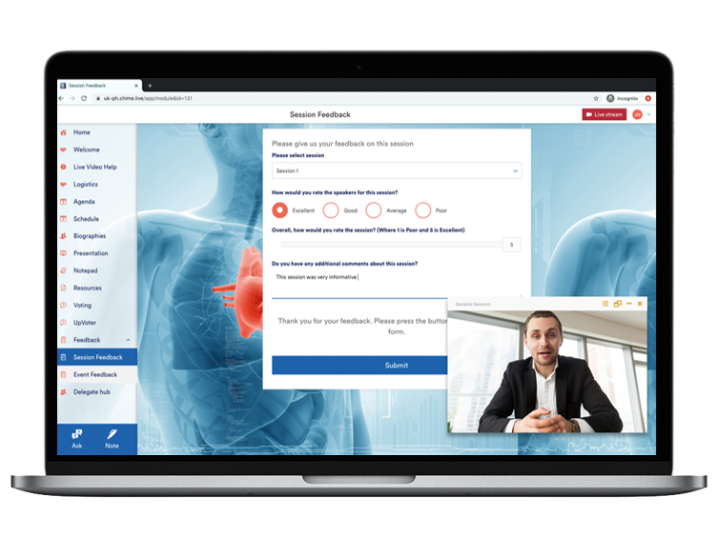

Engagement Bundle
For meetings that need a more targeted approach to participant engagement, you can add our Engagement Bundle to your platform experience.
This bundle offers a targeted set of features aimed at driving your message home and receiving active feedback from your participants.
Drive Engagement
Increase Participation
Drive Engagement
Push notifications to update your participants
Push sponsorship content to direct participants to sponsor information.
Push surveys, World Clouds, and Polling to gather insightful feedback.
Provide session-based Q&A to give your attendees a voice in the discussion
Integrate with social media to spread buzz and excitement regarding your event
Send a custom mailer to each of your attendees containing their event notes
Review your advanced event analytics to capture valuable information and improve future events

