Slide 1
VersaFlex® XSL Expandable Liner Hanger System
Technology Brief

Slide 2
What is it?
The VersaFlex® XSL hanger system is designed to improve the deliverability of a low-to-moderate load-bearing expandable liner hanger without sacrificing its gas-tight sealing capability or reliability.
The system can bring significant value to your well construction project without compromising quality and continues the legacy of our industry-leading expandable liner hanger technology with a total system approach to liner installations.
VersaFlex® Tieback Seal Assembly
VersaFlex® XSL Expandable Liner Hanger
Notes:
Halliburton’s VersaFlex® XSL expandable liner hanger system takes the standard VersaFlex liner hanger another step forward. Current designs are available for 7”, 7 5/8” & 9 5/8” casing in various standard weight ranges.

Slide 3
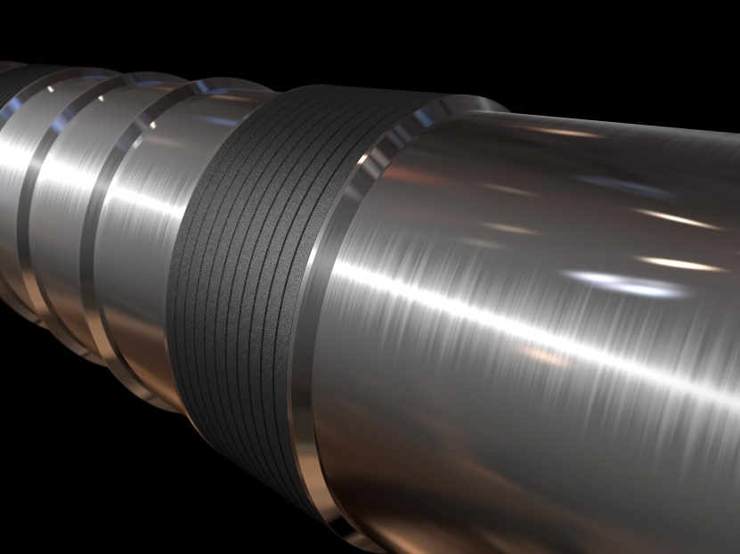
How it will Benefit you
Less parts, less problems
Maintains performance and hang-weight capabilities of low to moderate load bearing liner hanger system
Reduces ECDs and improves flow rates
Minimizes leak paths
Reliable, engineered solution

Slide 4
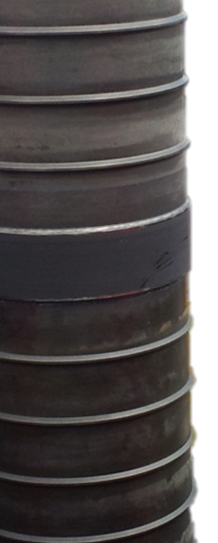
Why it will Help
Set-and-forget sealing – design simplicity helps eliminate risks
Tieback capable
Unmatched, redundant gas-tight seal reliability
High circulating rates up to 3500 psi
Engineered extrusion spikes (non-damaging to parent casing ID)
Running tools provide hydraulic hanger body expansion – no string weight to set required

Slide 5
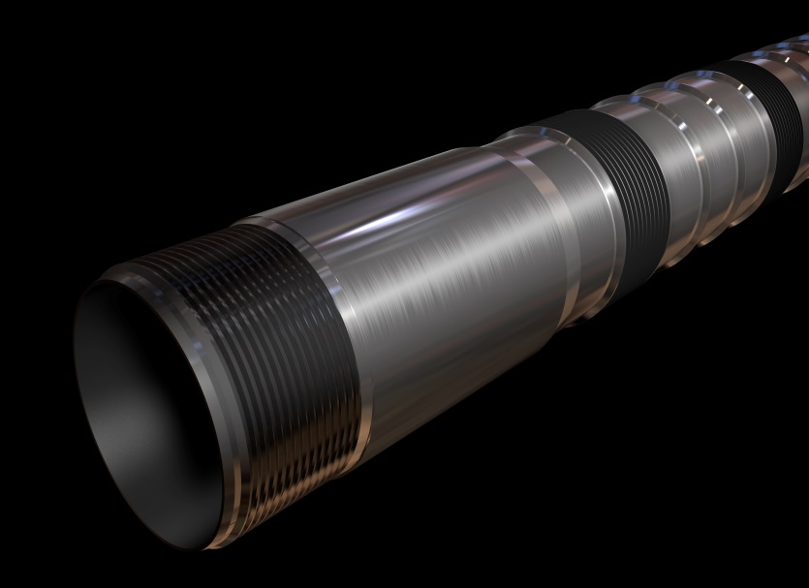
Unique Features
Simple, clean-form design
No external moving parts
Metal-to-metal seal with resilient elastomeric seal
360-degree hydraulically energized compliant seal
Engineered extrusion limiter rings
Non-damaging to parent casing
Integral upper tieback receptacle
Variable lengths available
Single component, single task function
Anchor load separated from sealing mechanism
Reduced number of threaded connections

Slide 6
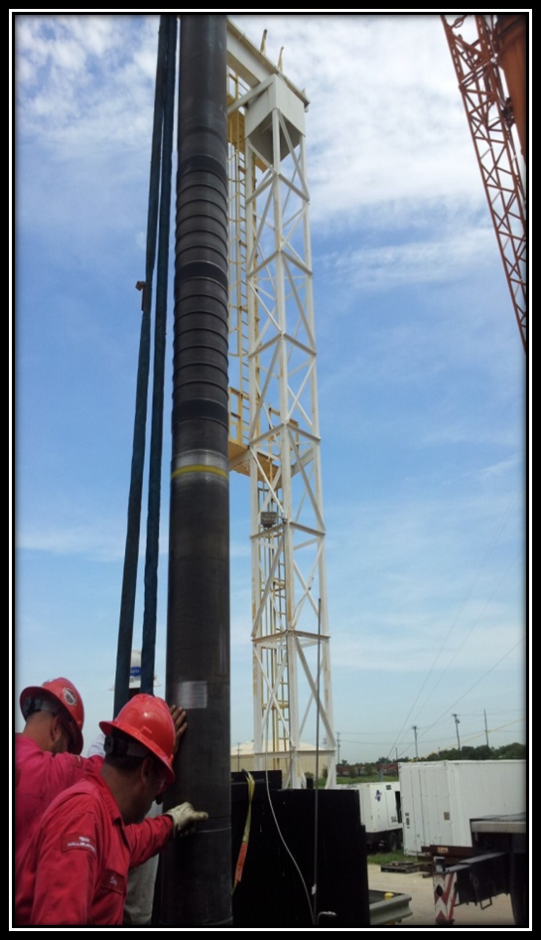
Where it Will Work
Oil or gas wells requiring a liner be deployed to total depth with an engineered bi-directional anchor and seal on setting the hanger at desired depth
Onshore/offshore, vertical, highly deviated, and some horizontal applications for both cemented or non-cemented liners
Contact your Halliburton specialist to determine which liner hanger system is best suited for your application

Slide 7
Challenges Addressed
Liners at elevated temperatures
Maintains hang-weight and sealing capability of a low-to-moderate load bearing liner hanger system
Trip time
No slips – mitigates risk in deployment and setting
Standard wash and ream capabilities
Alleviates low ECD formation issues
Maximizes circulating rates and circulating pressures
No need for “HWDP or drill collars” to set liner-top packer
Sets and seals in highly deviated wellbore
Reduces parent casing wear
Allows for string design simplicity
Overlap requirement
Sets in any section of the parent casing tube reducing the amount of liner required
Cement not required for seal
Parent casing
Anchors in any casing grade or hardness
Poor zonal isolation
Alleviates low ECD formation issues
Rotate and reciprocate during deployment and cementing
Liner-top remediation and reliability
Reduces or eliminates liner-top remediation
Provides gas-tight, liner-top seal upon setting
Maintains bi-directional anchor and seal

Slide 8
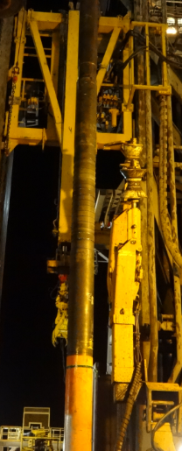
When its Helpful
VersaFlex® XSL liner hanger system offers a unique body profile utilizing engineered extrusion limiter rings
Provides metal-to-metal seals and full bi-directional anchoring capability in all casing grades
Strategically placed, bonded elastomers provide a resilient seal in the event of parent casing imperfections
Standard clean-form design offers a smooth radial flow path that results in unrestricted bypass area, reducing ECDs during all phases of the operation
Need for a low-to-moderate load-bearing expandable liner hanger without sacrificing its gas-tight sealing capability or reliability

Slide 9
Existing Portfolio and Standard Design Features
System Size (in.) | Parent Casing Weight (lb/ft) | Maximum Elastomer OD (in.) | Tieback Receptacle Sealbore ID (in.) | Tieback Receptacle Sealbore Length (in.) | Expansion Body Material (ksi MY)
5 x 7 | 29.0 - 32.0 | 5.88 | 5.25 | 127.35 | Low Alloy Steel, 80 ksi MY
5 1/2 x 7 5/8 | 29.7 - 33.7 | 6.56 | 5.75 | 126.17 | Low Alloy Steel, 80 ksi MY
7/7 5/8 x 9 5/8 | 47.0 - 53.0 | 8.325 | 7.75 | 123.80 | Low Alloy Steel, 80 ksi MY
5 x 7 | 29.0 - 32.0 | 5.88 | 5.25 | 127.35 | Low Alloy Steel, 110 ksi MY
5 1/2 x 7 5/8 | 29.7 - 33.7 | 6.56 | 6.75 | 126.17 | Low Alloy Steel, 110 ksi MY
7/7 5/8 x 9 5/8 | 47.0 - 53.0 | 8.325 | 7.75 | 123.80 | Low Alloy Steel, 110 ksi MY
Standard Features:
Pressure Rating excluding TBR | (Post expansion - below) 8000 (80ksi) / 10000 (110ksi)
Temperature Rating (F) | 325
Element Material | Metal-to-Metal / Fluorocarbon
Body Material | Low Alloy Steel
Bottom Connection | Blank
TBR Length, nominal (ft) | 10
Quality Plan | Halliburton Standard

Slide 10
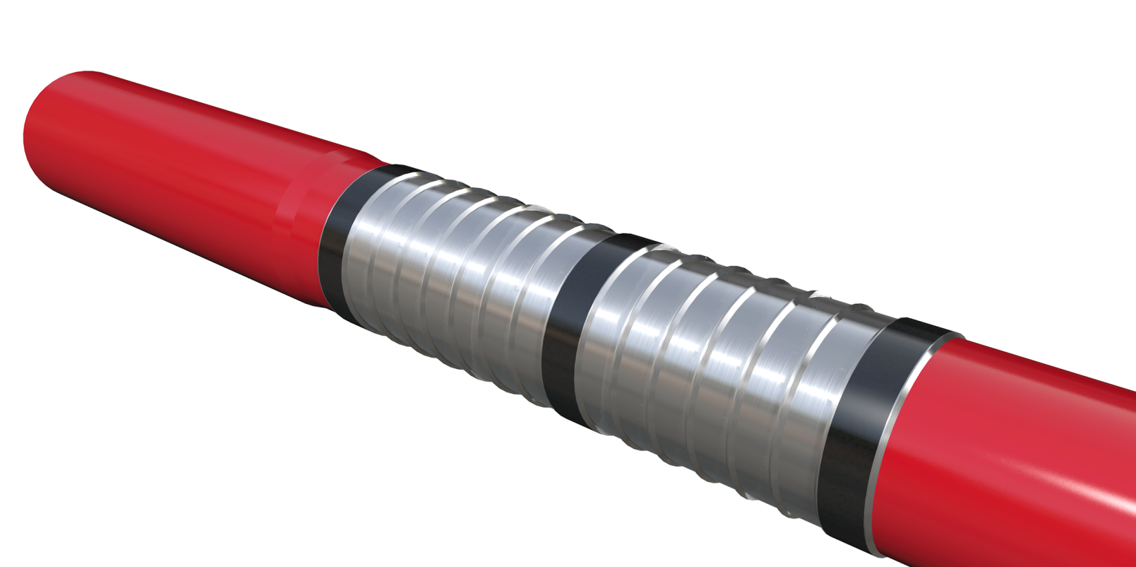
Summary
VersaFlex® XSL liner hanger system offers bi-directional anchoring with MTM sealing capabilities in low-to-moderate load bearing liner hanger applications.
This system allows us to differentiate from the current VersaFlex standard element design while maintaining high reliability across our portfolio of systems.

Slide 11
Who to Contact, Where to get more information
James Williford Global Product Champion – Expandable Liner Hanger Systems
james.williford@halliburton.com
Phone: 281-575-3097 Fax: 281-575-4995
Cell: 281-660-4724
www.halliburton.com/VersaFlex

