Slide 1
Illusion® Dissolvable Frac Plug
Notes:
Alternative title slides available in slide master including internal & external versions. Right click slide and click Layout.

Slide 2
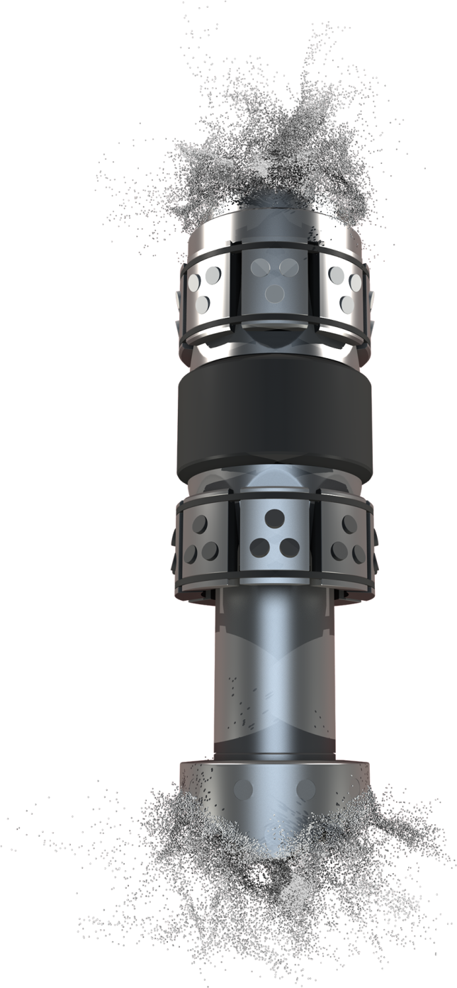
What is Self-Removing Technology?
Family of degradable technologies
Dissolvable metals
Dissolvable plastics
Dissolvable rubber material
Halliburton’s self-removing products:
RapidBall™ self-removing balls
DM – Dissolvable metal
DP – Dissolvable plastic
Illusion® frac plugs
Consists of dissolvable metal and dissolvable rubber element package
Notes:
What is self-removing technology?
Family of degradable products
These products use dissolvable materials that consist of:
Dissolvable Metals
Dissolvable Plastics
Dissolvable rubber materials
These materials dissolve over a period of time based on wellbore fluids and temperature.
Halliburton’s current product offerings in self-removing materials consist of:
The RapidBall™ self-removing frac ball. This self-removing frac ball is compatible with Halliburton’s RapidSuite™ sleeve systems and Halliburton frac plugs.
This self-removing ball eliminates post-stimulation intervention, allows for the well to be brought onto production faster and reduces completion costs.
There are two options available: a dissolvable metal ball or a dissolvable plastic ball depending on the wellbore environment.
Halliburton also offers a fully dissolvable frac plug called the Illusion® frac plug.
This plug is manufactured from dissolvable metal and a dissolvable rubber element package.

Slide 3
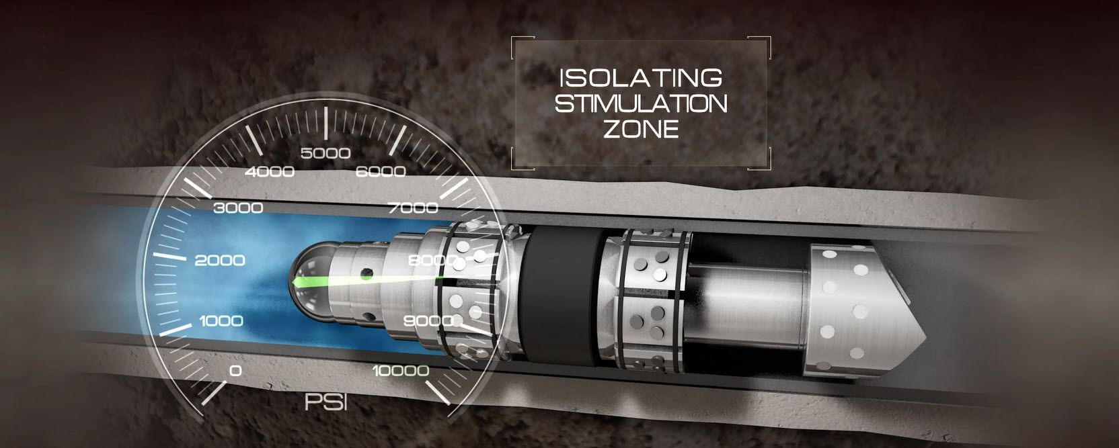
Illusion® Frac Plugs - Self-Removing Technology
Proven design with the latest technology
Plugs made from advanced dissolvable metal and dissolvable rubber materials
3 ½-in. to 6-in. plugs are rated for 10,000 psi
Large ID (1.50-in.) to assist immediate flowback and well cleanup
Short compact design aids in pump-down efficiency
Upon complete dissolution provides full wellbore ID for future operations
Notes:
The Illusion® dissolvable frac plug is the latest addition to Halliburton Unconventional Completions.
Combines Halliburton’s industry-leading frac plug designs with a proprietary blend of dissolvable metal and dissolvable rubber materials.
These plugs have been tested and rated to 10,000psi fracturing applications.
The large bore ID (1.50-in.) allows operators to produce through the plug or allow it to remain in the wellbore where the dissolvable material technology will begin the dissolution process immediately following the frac.
The short compact design of the tools aids in pump down efficiency.
Upon complete dissolution provides an entire wellbore ID for future operations. The plug dissolves from the ends towards the center and from ID out towards the OD. (surface area will play a role in the dissolution process)

Slide 4
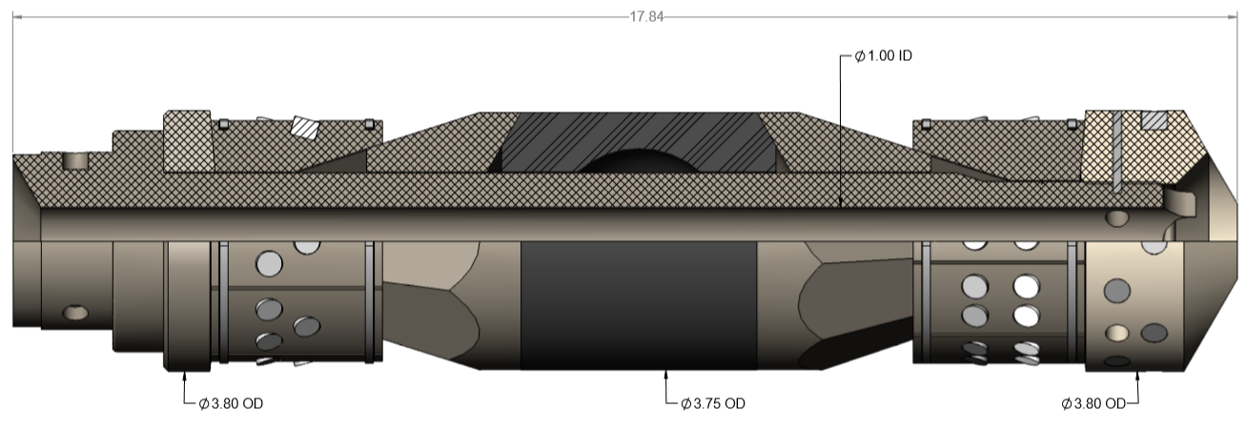
Illusion® High Expansion Frac Plugs
4" 11.60# Tubing to 4 ½” 11.60# Casing ( 3.428" to 4.00" ID)
5" 21.40# Casing to 5 ½” 20.00# Casing (4.126" to 4.778" ID)
Notes:
Refrac market and secondary recovery
Two key applications: 1) passing through a restriction/deformed casing 2) small OD for customers that prefer it

Slide 5
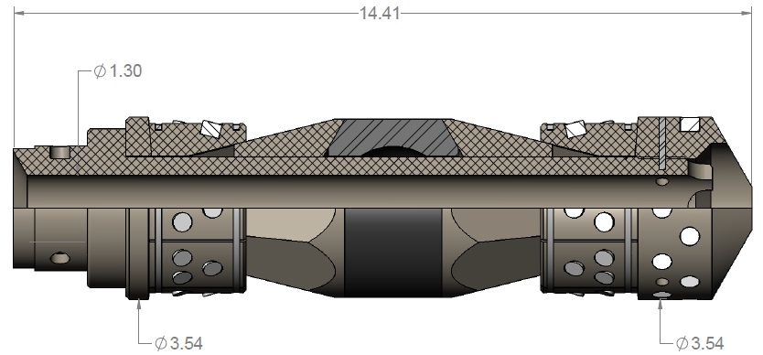
Illusion® Platform
Relative Dissolution Rate
DM-LT
DM-LT2
DM-ND
DM-200
DM-100
DM-HT2
Notes:
If I were to drop all these plugs in the same bucket of water – relative dissolution is how quickly they would dissolve compared to one another. LT being the fastest, HT2 being the slowest
Component materials selected based on anticipated environment – need to understand the environment in order to get it right
Refer to D01715954 Dissolvable Frac plug reference data sheet on halworld for description of each variant of plug offering (i.e. DM-LT, DM-200 etc)

Slide 6
Why it helps
Interventionless cleanout
Combine Illusion® frac plug assembly with Halliburton’s RapidBall™ DM self-removing ball technology to create an interventionless wellbore cleanout
Helps reduce the cost and risk associated with conventional plug removal
Notes:
When the Illusion frac plug is combined with the dissolvable RapidBall technology this creates an interventionless wellbore completion.
Helps eliminate the costs, time and risks associated with conventional plug removal, limited coil tubing mill out operations required.
After the stimulation operation the Illusion frac plug and the RapidBall technology will start the dissolution rate, based on the fluids and temperature of the wellbore.
The large bore ID (1.50-in.) allows operators to produce through the plug and allow it to remain in the wellbore where the dissolvable material technology will begin the dissolution process immediately following the frac, therefore, production is never disrupted.
Profiles milled into the downhole end of the mandrel will not allow a ball to flowback and plug off production. The flow area of the milled slots is calculated to be more than the flow area of the ID of the mandrel.

Slide 7
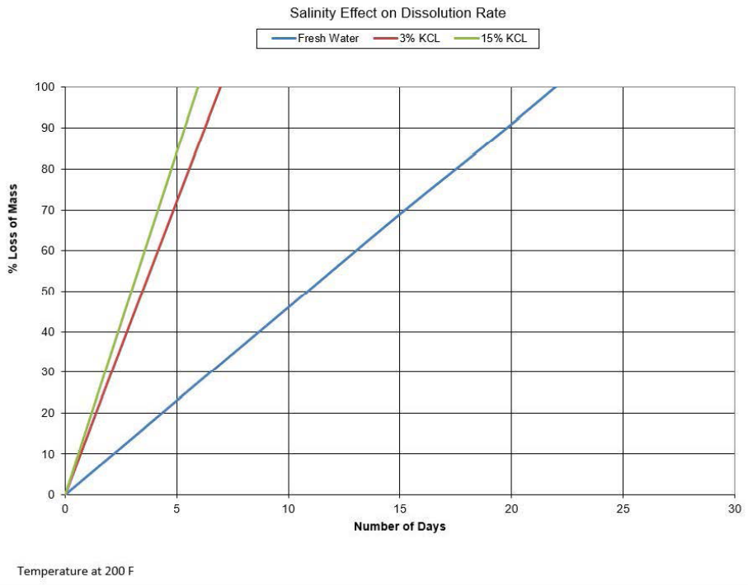
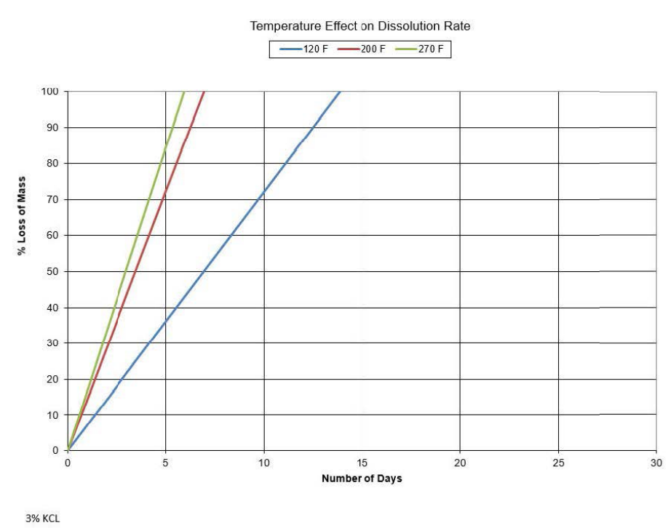
Tested and Proven
Dissolution rates
Illusion® frac plug dissolution rate is dependent on wellbore temperature and salinity
Testing has proven that this plug will dissolve at low temperatures and in fresh water
Notes:
The higher the temperature and the higher the salinity the faster dissolution rate.
The chart shown has been developed from several tests completed to compile data points for dissolution rates.

Slide 8
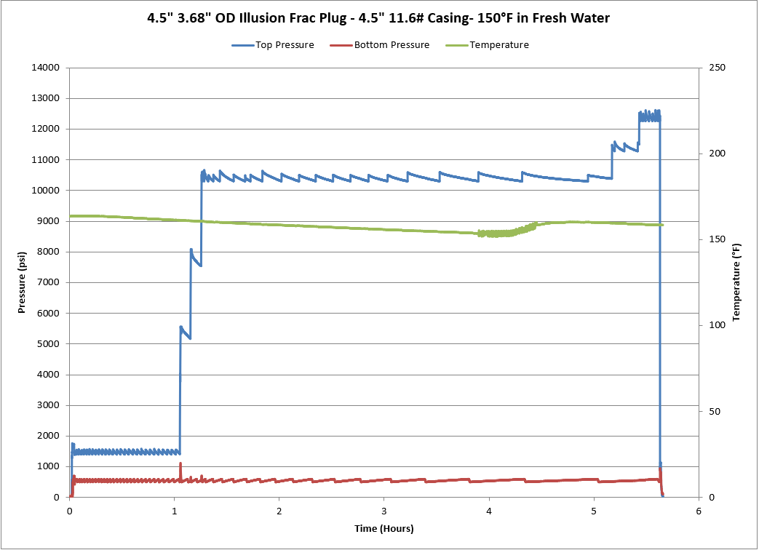
4 ½-in. Illusion® Frac Plug Assembly Pressure Testing
Notes:
10,000 psi rated frac pressure
Pressure Tests
150F
4+ -hour pressure test over 10k
10,000 psi 150°F (both 4 ½-in. and 5 ½-in. assembly)

Slide 9
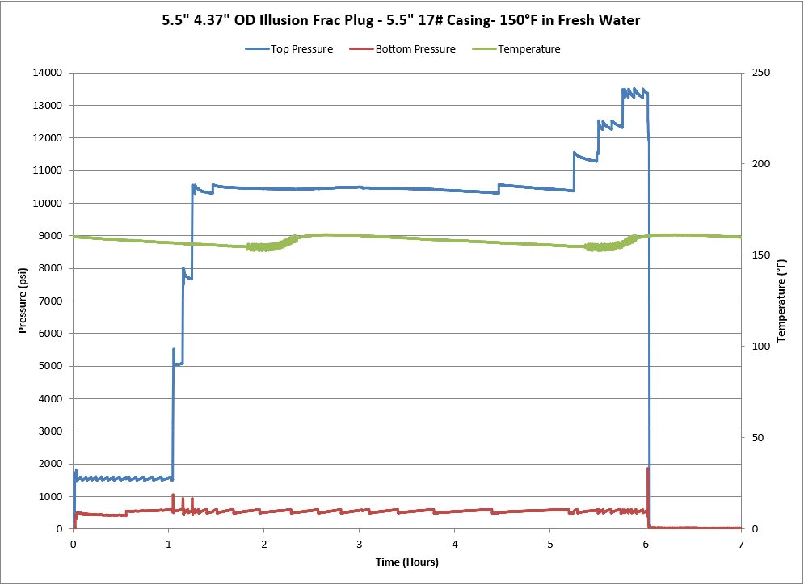
5 ½-in. Illusion® Frac Plug Assembly Pressure Testing
Notes:
10,000 psi rated frac pressure
Pressure Tests
150F
4+ -hour pressure test over 10k
10,000 psi 150°F (both 4 ½-in. and 5 ½-in. assembly)

Slide 10
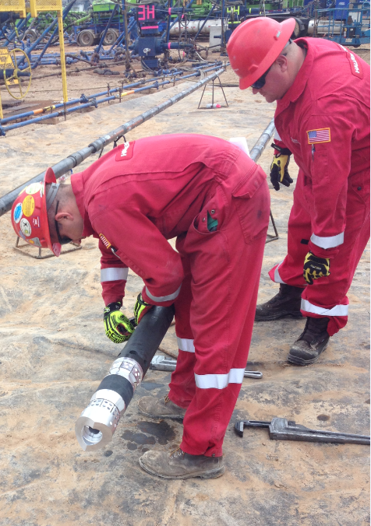
Illusion® Frac Plug Setting Procedure
Wireline
Compatible setting procedures with commonly available powder type setting tools (HES, Baker, etc.)
Adapter kits are needed to attach the plug to the setting tools
Slickline
Illusion® plugs are designed to be set with the HES downhole power unit when using slickline
An adapter kit is needed to attach the plug to the downhole power unit
Notes:
The Illusion frac plugs were designed to have the capability of utilizing commonly available powder charge setting tools such as the Hallliburton GO setting tools and the Baker 10 and Baker 20 setting tools. An adapter kit must be used to connect the plug to the bottom of the setting tool. The plug will be connected to the tension mandrel with shear screws and the setting sleeve of the adapter kit will slide over the top of the plug, to compress and set the plug. It is recommended to use a slow burn powder charge with a burn time of 15 seconds or longer to set these plugs, although we have set several of these utilizing the quick burn charges with 2-3 second sets.
The Illusion frac plug can also be set on slickline with the use of a downhole power unit to provide power to stroke the setting tool.
A best practices guideline for operating instructions has been developed and available, which provide step by step instructions on installation and setting procedures, D- Document # D00980393.

Slide 11
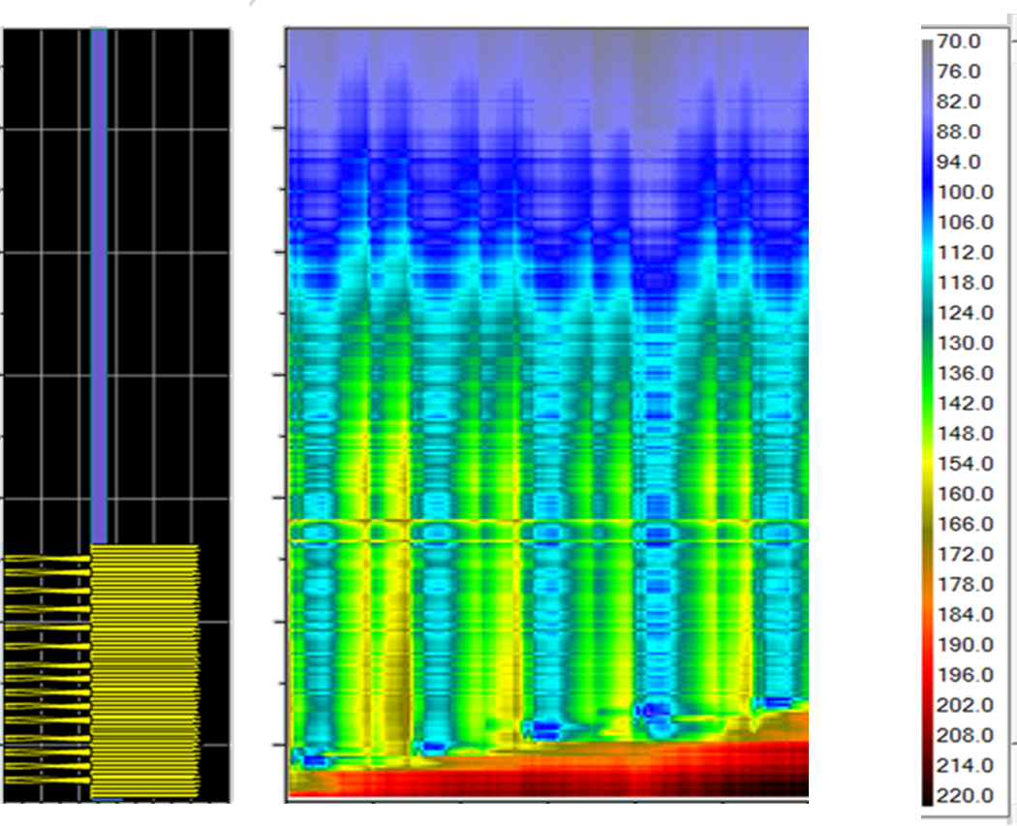
Cooling Effects in Wellbore P&P
Pump Down
Frac Plug
Distance
Stimulation
Time
Temperature
Notes:
This example well for this plug and perf scenario has a bottom hole static temperature around 200-210°F
Pump down the frac plug (cools the wellbore down into the 140°F range)
Drop a dissolvable ball
Stimulate the well for a period of time (well temps are down to 112-118°F)
Shut down the fracturing operation
The wellbore starts to warm up again around 136°F
Then pump down the next plug, (cools the wellbore down again)
Set the plug, drop a ball and stimulate the well, so on and so forth up the wellbore
This example shows the actual operating temperatures the plugs are likely to see in a plug and perf completion
We have completed dissolution rate testing in ranges from 150F up to 250F. Frac pressure testing of 10k was completed at 150F.
Is there a maximum well temperature rating for these plugs? As long as we are able to cool the wellbore down during the stimulation and hold the frac pressures then the plug will work as intended.

Slide 12
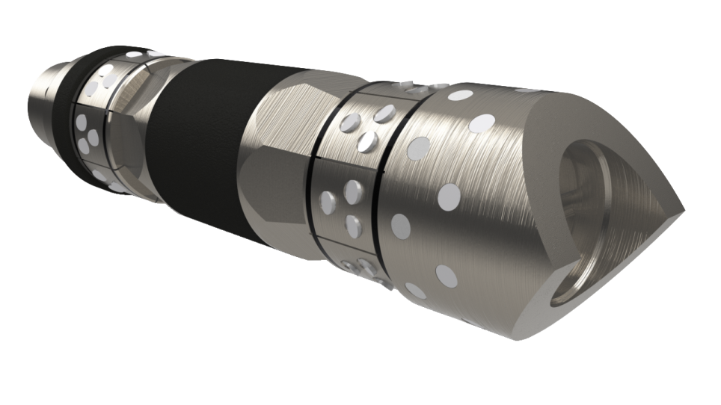
In Summary
Plugs made from advanced dissolvable metal and dissolvable rubber materials
3 ½-in. to 6-in. plugs are rated for 10,000 psi
Large ID (1.50-in.) to assist immediate flowback and well cleanup
Short compact design aids in pump-down efficiency
Upon complete dissolution provides full wellbore ID for future operations
Helps reduce the risks, costs, and time associated with conventional plug removal operations
Combine Illusion® frac plug assembly with Halliburton’s RapidBall™ DM dissolving ball technology to create an interventionless wellbore completion
Notes:
Summary Notes: Key Items

