Slide 1
Conga Composer
Streamlining document automation for faster revenue generation

Slide 2
This template is designed to help you present a strong case for investing in Conga Composer to your management team. It provides a framework that you can customize with your organization’s specific information. Update placeholders in brackets with your company’s relevant details. Remove any slides that are not relevant to your audience. This deck is a starting point—adjust it as needed to match your organization’s tone and priorities.
How to use this deck

Slide 3
Executive summary
[Highlight your business challenge]
[Propose the solution: Conga Document Automation]
[Mention anticipated benefits.]
[Examples:]
Increased efficiency: Automating document generation reduces manual effort, allowing teams to focus on higher-value tasks.
Enhanced accuracy: By pulling data directly from Salesforce and other systems, Conga Composer minimizes errors associated with manual data entry.
Consistent branding: Advanced template features to ensure all documents adhere to company branding guidelines, maintaining a professional appearance.
Scalability: Conga Composer supports high-volume document generation, making it suitable for organizations of all sizes.

Slide 4
The problem
[Describe your pain points]
[Data or examples that show the problem]
[Highlight how the current processes are costing time, money, opportunities, etc.]
[Examples:]
Teams spend 40% of their time on manual document creation, leading to delays and errors.
Current tools result in 20% error rates in contracts, exposing us to compliance risks.

Slide 5
The solution: Conga Document Automation
Fully automate business-critical documents
Create standardization and consistency across the team
Scalable, flexible, and customized to meet our business needs
Deliver a better experience for customers and employees
Automatically generate business documents, such as proposals, quotes, contracts, and agreements
Shorten your time to close critical deals
Build automated and accurate processes wherever you work (any CRM/ERP)
Merge data from any system into a templates
Fully control standardization and branding of documents
Eliminate manual errors and rogue discounting
A world-class pairing of Enterprise-grade document generation and eSignature solutions
Larger document sizes, with pixel-perfect images, charts, and tables to your prospects and customers
Create ANY document to meet your sales needs, including Word, PDF, PowerPoint, Excel, and HTML
Fully white label your document and agreement process
Improve collaboration across multiple functions, including sales, legal, finance, and operations
Create a seamless experience for customers to execute agreements simply, securely, and on-demand all within a unified document and signature experience.

Slide 6
Business impact
[Demonstrate how the software will drive measurable results:]
Efficiency gains: [x amount] time saved or [x] processes streamlined.
Cost savings: [x amount] reduced manual work or [x] lower operational expenses.
Revenue growth: faster sales cycles or reduced errors that increase profitability.
Tech stack consolidation: Conga handles document generation and eSignature, solutions to transform your entire agreement process.
Leverageable by multiple departments: [see next slide]
Results achieved with Conga Composer
80%
less time spent updating documents manually
160k+
hours saved annually on document generation
12x
faster quote generation

Slide 7
Top use cases by department
Sales
Marketing
Finance
Legal
Customer
Success
Proposals
Quotes
Contracts
Service agreements
Non-disclosure agreements (NDAs)
Change orders
Authorization to release information (ATI) forms
Proof of insurance forms
Asset verification forms
Income verification forms
Warranty agreements
Return authorization forms
Refund agreements
Termination agreements
Sales onboarding documents
Marketing communications
Marketing collateral
Lead capture forms
Email marketing opt-in forms
Content marketing agreements
Sponsorship agreements
Event registration forms
Speaker agreements
Media kit agreements
Press release distribution agreements
Social media marketing contracts
Content creation agreements
Bills and Invoices
Vendor invoice approval
Loan agreement signing
Expense report execution
Travel and expense reimbursement authorization
Vendor onboarding
Employee onboarding
Employee benefit enrollment
Purchase order approval
Change order signing
Shareholder agreement execution
Financial report approval
Tax form signing
Contracts
Agreement approval
NDA
POA execution
Will signing
Trust signing
Power of appointment execution
Settlement agreement
Non-compete agreement
Non-solicitation agreement
Confidentiality agreement
Release of liability
Waiver of rights
Service of process delivery
Subpoena delivery
Onboarding agreement
Customer agreement
Service level agreement (SLA)
Customer support ticket resolution
Change request approval
Upsell/cross-sell proposal
Product trial agreement
Beta testing agreement
Customer feedback form
Satisfaction survey
Product review
Account cancellation notice
Refund request approval
Dispute resolution

Slide 8
Alignment with company goals
[Connect the solution to strategic priorities such as revenue growth, operational efficiency, tech stack consolidation, compliance, risk reduction, employee productivity or satisfaction]
[Include any KPIs associated to these goals]

Slide 9
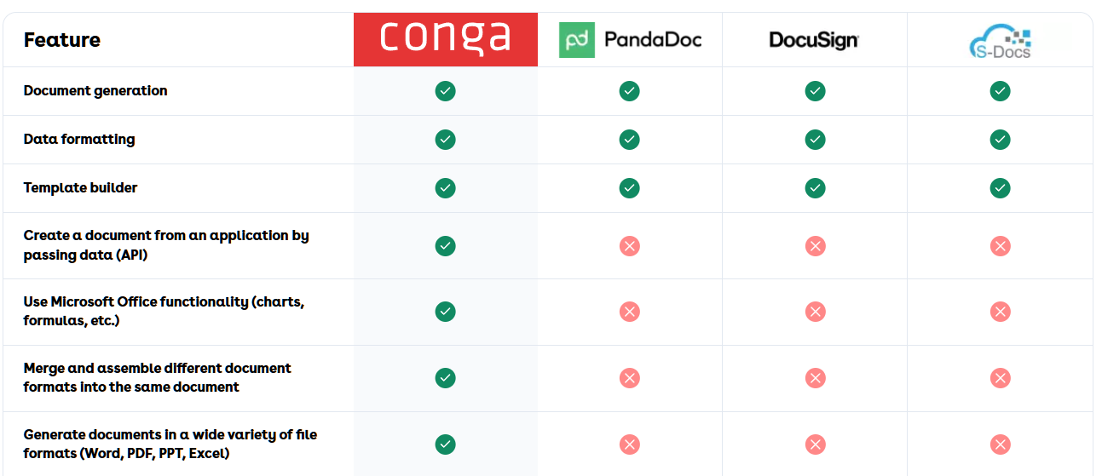
Competitive analysis

Slide 10
Next steps
[Outline what you need from leadership: approval for funding, allocation or resources, etc.]
[Reiterate the potential success short-term and long-term]

