Slide 1
[MONTH XX, XXXX]
RETIREMENT PLAN ESSENTIALS
Making the most of a valuable workplace benefit
Presented to:
[Client Name Here]
This presentation has been customized by the plan's financial advisor who is not affiliated with Transamerica. Transamerica disclaims the accuracy of plan specific information or any other information input into this presentation by such advisor.
Notes:
[NOTES FOR CLIENT-SPECIFIC VERSION]
Welcome everyone, thank you for joining me today for our presentation on the features and benefits of your employer’s retirement plan.
My name is ……. (FA’s value proposition/credentials).
I’d like to start our presentation today with a question: How do you envision spending your retirement? If you were to receive a postcard from your future, retired self, what would it picture? (Long pause….)
Many people envision their retirement as a time to indulge themselves doing the things they enjoy most; such as traveling, enjoying their favorite hobby, spending time with family, or maybe even starting a new business. No matter what your retirement dream or vision is, the most important thing you can do today is create a retirement strategy that will turn your vision into a reality, and one of the best tools you can use as part of that strategy is your employer’s retirement plan.

Slide 2
TODAY’S AGENDA
Importance of saving for retirement
How your retirement plan can help
Plan features & services
How to enroll today
How Transamerica can help
Notes:
Before we dive into the features and benefits of your employer's retirement plan, I'd like to talk about the importance of saving for retirement, and some of the challenges you’ll face along the way. We'll then cover how your retirement plan can help overcome these challenges and review your specific plan features and services that can help.
Then I'll walk you through the enrollment process so you will know exactly what to do to optimize your employer's plan. At the end, if you have any questions or need assistance, I'll review the many resources available at Transamerica to help you. I’m also happy to schedule an appointment with you to take a closer look at your personal retirement strategy.
So, let's start with talking about what may be one of the biggest challenges of all: Saving for retirement.

Slide 3
IMPORTANCE OF SAVING FOR RETIREMENT
Notes:
Saving for retirement is something many people would like to do, but it can be a challenge with all of today’s competing priorities.
If you're like many people, it can sometimes be tough just to meet everyday expenses like your mortgage or rent, car payments, groceries, phone and energy bills – not to mention setting aside additional money for other things that are important to you like sending the kids to college or taking a vacation now and then. But one of the most important aspects of a successful retirement strategy is saving as much as you can, as soon as you can. Saving now and saving as much as you can afford are tried and true habits that will help you achieve the retirement you envision.
Let’s take a closer look at why this is so important.

Slide 4
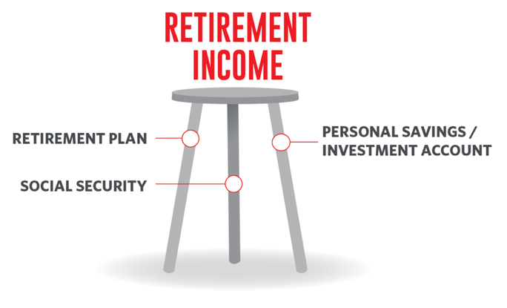
SOURCES OF RETIREMENT INCOME
Notes:
Some of you may have heard of the "three-legged" stool of retirement income. This refers to the three primary sources of income for most people in retirement: Social Security, employer sponsored retirement plans, and personal savings.
To learn more about how these pieces come together to build a retirement strategy, I encourage you to attend or view some of the other presentations Transamerica offers. But for the sake of today's presentation, we're going to cover the basics to illustrate why saving for retirement, using all three legs, is so important.
Let's start with Social Security.

Slide 5
QUICK FACT:
Average Social Security Benefit
$1,907/month
$22,884/year
As of October 2023*
Can you live comfortably on that?
* “Fact Sheet: 2024 Social Security Changes,” Social Security Administration, October 2023
Notes:
Here is a quick fact for you to think about.
As you can see, the average Social Security benefit is around $1,900 per month, which comes to almost $23,000 per year. The amount you will receive from Social Security is based on several factors including the amount of income you earn and how long you have worked. So, it's different for everyone. For most people, the amount of income they expect to receive will only cover a portion of the income they would like to have when they retire.
For many of us, most of our retirement income will come from the money we set aside in our workplace retirement plans and our personal savings. You may then be asking, “how much money will I need to comfortably retire”?

Slide 6
Retirees today need about 80% of their annual income in retirement to retire comfortably.
Notes:
Most financial professional agree that that the average person will need approximately 80% of their pre-retirement income to sustain the same lifestyle after they retire. The kind of retirement you will be able to enjoy depends largely on how you save for retirement now while considering other key factors as we save for this income replacement goal.
Another important factor to consider is how long you will live. Unfortunately, we don't know how long we're going to live and how long our retirement savings will have to last. However, we can estimate. According to the Social Security Administration, one out of three adults at age 65 today will live past 90, and one in seven will live past 95. So, we need to plan on longevity being a reality.
Finally, we also need to consider the cost of living during our retirement years. The costs of goods and services today will not be the same during our retirement years. As a matter of fact, the cost of living will likely be more due to inflation. While 80 percent of our annual income may be sufficient when we retire, that amount of income will likely need to increase over time, due to inflation.
I’m sure everyone has felt the impact of record high inflation in recent months whether it’s at the grocery store or at the gas pump. While it’s certainly had a significant impact on our economy, it’s important to remember that surges like this are historically more short-term spikes rather than long-term trends. With that in mind, let’s look at an example of the impact of inflation over time.

Slide 7
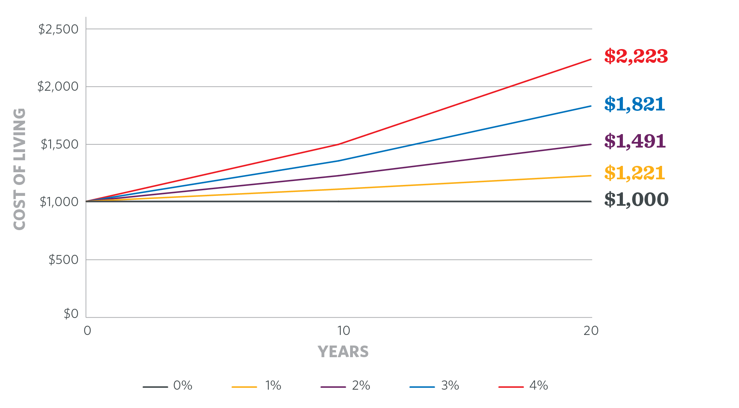
Outpace inflation
INFLATION ERODES YOUR PURCHASING POWER OVER TIME
How much will $1,000 of expenses cost with inflation?
Assumptions: $1,000 present value with inflation rates of 1%, 2%, 3%, and 4% compounded monthly over 20 years.
Illustration is hypothetical and not meant to reflect the return of any specific investment.
Notes:
Let’s say you put aside $1,000 today to use in retirement — whether that’s 10, 20, or 30 years from now — at a minimum, I’m sure you’d like that $1,000 to buy then what it buys today. For that $1,000 to retain its “purchasing power,” you need it to grow to keep pace with inflation.
This chart shows the impact of different rates of inflation on $1,000. On the right, you’ll see what you need your $1,000 today to grow to over 20 years, just to maintain its “purchasing power,” or be able to buy what it can buy today. Each color-coded line represents a different potential inflation rate.
Not only is it important that we save for retirement, but we need to have those savings grow over time to ensure our income in retirement keeps pace with inflation.

Slide 8
HOW CAN YOUR RETIREMENT PLAN HELP?
Notes:
Let’s take a moment to recap some of the keys to a successful retirement strategy.
1. We should all try to save as much as we can, as soon as we can.
2. We'll probably need to rely on more than just Social Security in retirement.
3. We'll need to put the money we save to work, so that money can grow and help us keep pace with inflation.
The features and benefits of your workplace retirement plan can help you along the way. It begins with enrolling in the plan as soon as you are able, then contributing what you can afford, and finally investing your money appropriately!
Let’s look at how you can accomplish this in more detail.

Slide 9
Why contribute to the plan
Benefits of taking full advantage of your employer’s retirement plan include:
A tax-advantaged way to save for retirement
A systematic way to save on a regular basis
A variety of investment choices to help your savings grow
Notes:
Your retirement plan offers benefits that are unique to those who enroll in the plan. The most significant benefits are that it offers you a tax-advantaged way to save for retirement, a systematic way to save for retirement on a regular basis, and a variety of investment choices that can help your savings grow.
Let’s look at the powerful, tax-advantaged ways to save.

Slide 10
THE SAVER’S CREDIT
LOWERS FEDERAL INCOME TAXES DOLLAR-FOR-DOLLAR
2024 Saver’s Credit
CREDIT RATE* | MARRIED FILING JOINTLY | HEAD OF HOUSEHOLD | ALL OTHER FILERS
50% of your contribution | Adjusted Gross Income (AGI) less than than $46,000 | AGI less than $34,500 | AGI less than $23,000
20% of your contribution | $46,001 - $50,000 | $34,501 - $37,500 | $23,001 - $25,000
10% of your contribution | $50,001 - $76,500 | $37,501 - $57,375 | $25,001 - $38,250
0% of your contribution | AGI greater than $76,500 | AGI greater than $57,375 | AGI greater than $38,250
Visit irs.gov for more information.
*Up to the first $2,000 ($4,000 if married, filing jointly).
Transamerica and its agents and representatives do not provide tax or legal advice. This material is for informational purposes and should not be construed as legal or tax advice. For legal or tax advice concerning your situation, please consult your attorney or tax professional.
Notes:
One tax advantage many people overlook is the Tax Saver's Credit. The federal government offers a tax incentive to people with moderate to low incomes. It’s known as the Saver’s Credit. A tax credit is different from – and can be better than – a tax deduction. That’s because while a deduction means only a percentage tax cut based on your federal bracket, a credit cuts your tax bill dollar-for-dollar.
Depending on your income and tax filing status, you may be able to get back 10, 20, or even 50 percent of the first $2,000 you contribute to your retirement plan in [2023]. That means you could cut your tax bill by up to $1,000 – or even $2,000 if you’re married and file jointly.
This chart shows the income requirements to receive this credit. Take a look here, or search for “The Saver’s Credit” on the IRS website – I-R-S-dot-gov.
If you don’t qualify for the Saver’s Credit, the federal government still offers additional tax-advantaged ways to save, so let’s look at other options available to everyone.

Slide 11
TAX ADVANTAGES with PreTax contributions
ANNUAL INCOME
PRETAX CONTRIBUTION
-
=
LOWER current taxable income
Contributions are made to the account before taxes. Therefore, your taxable income is reduced by the amount you contribute.
Generally, pre-tax contributions, plus investment earnings and dividends, are subject to income taxes upon withdrawal.
Notes:
The money you contribute to your employer’s retirement plan comes out of your paycheck before taxes, which reduces your taxable income. For example, say you earn $50,000 a year, and contribute five percent of that to your retirement plan. Subtract that five percent, or $2,500 in this case – and you’ll be taxed as if you earn $47,500. This benefit allows you to reduce your taxable income during your working years and possibly pay less taxes.
And while you save taxes on the money you contribute to the plan, that’s not all! The money you save in your employer’s retirement plan can grow tax deferred. This means when you invest the money within the retirement plan, the money earned on those savings each year isn’t taxed until you withdraw it. When you’re ready to take the money out at retirement, you pay income taxes on the contributions and any earnings. If your income is lower at retirement, you could possibly be at a lower tax rate. Be mindful that withdrawals before age 59-and-a-half may come with an additional 10 percent penalty.
The tax-deferred nature of retirement plan contributions is a key benefit, because you get to put those tax savings to work, potentially earning even more for your retirement.
This is a big reason why it’s important to save early.

Slide 12
TIME IS ON YOUR SIDE
DON’T DELAY
Even the smallest contribution can have a big impact down the road.
​Both save $130 per month and earn the same 6% annual growth. ​
Maria
Maria saves
Alex
$190,419
Assumptions: Each saves $130 per month with the same 6% annual return, with no wage increases, employer contributions, or inflation. Illustration is hypothetical and not meant to reflect the return of any specific investment.
Over 44 years, Maria contributes $68,640 and ends up with
more!
$321,659
Over 30 years, Alex contributes $46,800 but ends up with
Maria
Alex
$127,303
Age 21
35
65
Source: bankrate.com/calculators
Illustration is hypothetical and not meant to reflect the return of any specific investment.
Notes:
There’s nothing like having time on your side when building your retirement strategy.
Consider this scenario: A 21-year-old contributes $130 per month for 44 years (which totals $68,640) and earns an average of 6% investment growth annually. At 65, the account balance is $337,634.
Getting a later start, a 35-year-old contributes $130 per month for 30 years (which totals $46,800), with the same 6% annual growth. At age 65, the account balance is $131,240.
Now, the 21-year-old contributed a modest $22,000 more, but ends up with $206,394 in additional assets.
Once we enter retirement, we are no longer working and accumulating money for retirement. We have what we have.
The bottom line is you are the only one who can plan for your financial future, and when you’re saving for retirement, there’s nothing more powerful than time. The money you save today is how you’ll be able to provide for yourself and your loved ones tomorrow. Starting to save today is the important first step, and any percentage of your paycheck will make a difference.

Slide 13
Pick your percentage
Maximum Contribution:
[$23,000] [($30,500 if age 50+)]
Contribute 10%
Contribute 5%
of your current pay
of your current pay
10%
5%
Notes:
Now that we know that saving as much as you can as soon as you can is an important part of a successful retirement strategy, let me explain how your retirement plan can help you do this, too.
One of the most important goals to set for yourself is your contribution rate – meaning how much of your salary do you want to contribute to the plan, and remember, any amount is better than nothing.
If you’re just starting out, maybe try five percent. Then six months to a year from now, see if you can bump it up by one or two percent. If you strive to contribute between 10 to 15 percent of your salary, you can put yourself in a pretty good position to achieve your retirement goal. Transamerica has tools available on our website that can show you how your contribution rate will impact your retirement strategy, and the impact the changes to your contribution rate will make in reaching your goal.
When you enroll, you will have to specify a certain dollar amount, or a percentage of your salary, to automatically come out of your paycheck each pay period. One benefit of contributing a percentage of your salary instead of a fixed-dollar amount, is that your contributions increase every time your salary increases. So, in effect, your contributions automatically increase over time.
No matter what method you select, it is a convenient and disciplined approach to save on a regular basis. Saving on a regular basis is another key to a successful retirement strategy.

Slide 14
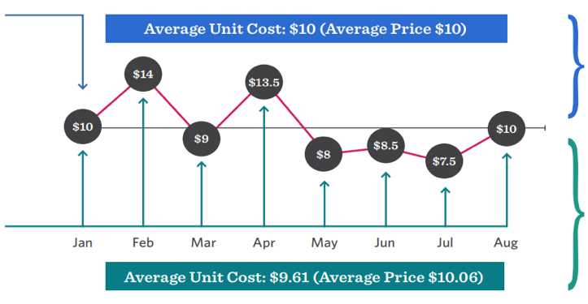
SMALL STEPS CAN ADD UP OVER TIME
DOLLAR-COST AVERAGING AT WORK
See how investing all at once, or with smaller amounts over time, can affect your returns.
Lump-Sum
Investment
$8,000
Return on Lump-Sum
Investment
0%
Monthly
Investment
$1,000
Return on Monthly
Investment
4.07%
Illustration is hypothetical and not meant to reflect of any specific investment. Dollar-cost averaging does not guarantee a profit or protect against a loss in a declining market, so you should consider your ability to continue investing through periods of adverse market conditions.
Notes:
Saving money is a good first step — and investing money on a regular basis is a good practice to help those savings grow over time.
Markets go up and down, and you may be nervous about possibly losing money. You may even think about investing only when times are good. Let me share some insight — there isn’t a bad time or good time for investing for the long term; it’s always the right time. A systematic approach of saving money on a regular basis, whether the market is up or down, is known as dollar-cost averaging.
Dollar-cost averaging provides an alternative to making a lump-sum deposit in investments at one time. Using the dollar-cost averaging strategy, an investor purchases more of the investment when prices are lower, and less of the investment when prices are higher. No matter how the market is fluctuating, regular purchases each pay period may lower the total average cost of investments over time.
Dollar-cost averaging does not guarantee a profit or protect against a loss in a declining market, so you should consider your ability to continue investing through periods of adverse market conditions. Thanks to compounding — the earnings on your earnings — even small, regular increases of your contributions can make a big difference over time.
At this point, you may be thinking this all sounds good, but if I contribute an amount on a regular basis, how do I invest it and make it grow?

Slide 15
PLAN FEATURES
Important details to help optimize your retirement plan
Notes:
[NOTES FOR CLIENT-SPECIFIC VERSION]
Every retirement plan is unique. You’ll find details of your specific plan in the plan summary document that was included in the webinar invitation. In this portion of the presentation, we’ll cover the important features available in your retirement plan.

Slide 16
Understanding terms and plan features
Common Terms
Eligibility
Auto-enroll
Contributions
Company match
Employer contribution
Vesting schedule
Notes:
Before you can start participating in your employer's plan, you’ll need to be familiar with certain terms and features and your plan’s requirements.
Let’s start with eligibility, which refers to the fact that an employee is eligible to participate in the retirement plan when certain conditions are met. Sometimes a plan may auto-enroll you once you become eligible. If you’re automatically enrolled, it’s important to review your account profile to make sure your contact information is correct, your beneficiary information is properly listed, and the investments you are allocated to are what you desire. You can also opt out of the plan after you are auto-enrolled.
A contribution is the amount an employee and/or employer pays into your retirement plan every paycheck. These contributions may be represented as a set dollar amount or as a percentage of your gross pay. Sometimes an employer will require a mandatory contribution, and/or a periodic automatic increase. These features are meant to make it convenient for you to maximize your savings in the plan.
You may be familiar with a benefit called a company match. This is when the employer contributes into the plan an amount that matches the employee contribution. If your company offers this, it’s advantageous to take full benefit of the entire match. An Employer Contribution is money the company contributes into the plan, regardless of whether you are contributing or not.
Should your employer offer a Company Match or Employer Contribution these funds are subject to a vesting schedule. Vesting refers to how long you must work for the company before these funds become yours. Please check your plan summary document to determine whether your plan offers either of these and what the vesting schedule might be.
Also, your investment options will be varied, let’s talk about what you should consider when deciding which way to go.

Slide 17
ELIGIBILITY
Eligibility requirements to enroll in the plan:
[Criteria 1]
[Criteria 2]
[Criteria 3]
Notes:
[OPTIONAL – CLIENT SPECIFIC (If plan has eligibility requirements)]
To begin, you’re eligible to join [PLAN NAME] if:
[Criteria 1]
[Criteria 2]
[Criteria 3]

Slide 18
You may have been auto-enrolled in the plan
Your plan auto-enrolls eligible employees. Eligibility for auto-enrollment is [enter auto-enroll requirements here]
Your employer set the contribution rate for auto-enrollment at [X%]
[Your employer has set your contribution rate to automatically increase by [X%] every [X years]. You can turn this off any time.]
This presentation will help you understand why the plan is important toward achieving a financially fit future
Don’t know whether you’ve been auto-enrolled? Please check with your employer.
Matching contributions may be subject to plan vesting requirements. Descriptions of plan features and benefits are subject to the plan document, which will govern in case of any inconsistencies.
Notes:
[OPTIONAL – CLIENT-SPECIFIC]
You are eligible to enroll in the [plan name] [and if you are a new employee, you will be auto-enrolled if [eligibility criteria].
Eligibility for auto-enrollment is [enter auto-enroll requirements here]. You can opt out after being auto-enrolled.
Your employer set the contribution rate for auto-enrollment at [X%].
[Your employer has set your contribution rate to automatically increase by [X%] every [X years]. You can turn this off any time.]

Slide 19
Pretax and roth contributions
C | TRADITIONAL | ROTH [401(k) 403(b)
Contributions | Pretax, lowers taxable income¹ | After tax
Earnings | Tax-deferred | Tax free³
Withdrawals | Income tax due on all distributions (10% IRS penalty may apply before age 59½) | No tax due on qualified withdrawals²
Required minimum distributions (RMDS) | If you turned 72 in 2022 or earlier and still work for the employer sponsoring your plan, you’ll have to take RMDs in the year you end employment. Otherwise, RMDs must begin in the year you turn 73 or end employment, whichever is later.* | Currently, your RMD calculation includes your Roth balance, unless you roll into a Roth IRA.** Beginning in 2024, Roth balances will be excluded from the RMD calculation (same treatment as IRAs).³
* This presumes you are actively employed (i.e., if you already terminated employment and are already 72, you should already have started receiving RMDs, or need to by April 1, 2023 if you turned 72 in 2022.
** If you’ve already passed the calendar year in which RMDs have to start, there will be an RMD due from your retirement plan for the year in which you rolled it over.
¹ Federal and most states.
² You must hold account at least five years and past age 59½. Other withdrawals may be subject to a 10% IRS penalty if you are under age 59½.
³ Employer-sponsored retirement plans may have features that you may find beneficial such as access to institutional funds, fiduciary selected investments, and other ERISA protections not afforded other investors. In deciding whether to do a rollover from a retirement plan, be sure to consider whether the asset transfer changes any features or benefits that may be important to you. Review the fees and expenses you pay to see if rolling over into an IRA could help reduce your costs.
Notes:
[GENERIC]
When enrolling in the plan, you might be given the option of making traditional pretax contributions or Roth after-tax contributions.
Both contribution types offer tax advantages when you defer a portion of your salary into your employer’s retirement plan. Both feature tax-deferred compounding of contributions that are made to the account and neither have income limits. Traditional contributions require minimum distributions after you turn 73 in most cases, and both can be rolled over to an IRA when you retire or leave your job for any reason.
Deciding which is right for you will depend on your current tax situation and whether your tax rate is likely to be higher or lower in retirement. The good news is that it’s often possible to make traditional and Roth contributions to your retirement account. Since no one knows what tax rates will be in the future, diversifying your contribution types might be a way to hedge your tax liability with your retirement savings. Of course, you can always schedule time with [me] [a Transamerica financial professional] to review your situation.

Slide 20
TAX ADVANTAGES WITH ROTH CONTRIBUTIONS
PAY TAXES NOW
Roth contributions are taxed now
Withdrawal and investment earnings are tax-free at retirement, as long as:
You’re at least 59½ years old
It’s been at least five years since your initial Roth contribution
Notes:
[OPTIONAL – CLIENT-SPECIFIC (If plan has Roth option]
If you make Roth contributions, you pay taxes today so there are no tax breaks when contributing. It also means you won’t have to pay taxes when you withdraw the money at retirement, provided you have reached age 59-and-a-half and it’s been at least five years since your initial Roth contribution.
You may wish to consult a qualified tax professional if you’re unsure whether to make pretax or Roth contributions — or both.

Slide 21
EMPLOYER MATCH & VESTING
Your contributions — always yours
[COMPANY MATCH][and][EMPLOYER CONTRIBUTIONS] [Yours no matter how long you’ve worked for CLIENT NAME] [Depends how long you’ve been with CLIENT NAME:
X% after X years
X% after X years
X% after X years
X% after X years
X% after X years
X% after X years]
Descriptions of plan features and benefits are subject to the plan document, which will govern in case of any inconsistencies.
Notes:
[OPTIONAL – CLIENT-SPECIFIC – PLAN HAS A MATCH. BE SURE TO EDIT BOTH X’S ON THE SLIDE – BLUE BAR AND RED HEADER.] – combined matching and vesting slide.
Hopefully, everything I’ve outlined so far drives home the point that it’s a good idea to participate in your workplace retirement plan as soon as possible. But you may be wondering where to begin.
One of the most important goals to set for yourself is your contribution rate – meaning how much of your salary you want to contribute to the plan. You’ll have to pick a percentage, which will automatically come out of your paycheck each pay period.
Your employer designed your retirement plan to include a match – this means your organization will contribute money into your account as long as you’re contributing a certain percentage – [state match formula here.] If you can, try to contribute at least enough to take full advantage of your employer’s match – otherwise it’s like turning down money you’ve already earned.
But think of the match as a starting point. Then maybe six months from now, see what happens if you bump it up by one or two percent. You may find out that you’re able to adjust to your new paycheck amount, and when you log in to your Transamerica account, it’ll be nice to see your contributions getting you ready for retirement, however far off that might be.
And if you’ve been in the plan for a while – you may not even remember what your current contribution rate is! [Optional for in-person meetings – anyone care to admit if they can’t remember what they’re contribution rate is?] If you’re not sure, make a point to log in to your account to see what it is today – and consider bumping it up by one or two percent.
[Optional notes for vesting schedule]
One additional note about your plan’s [matching contributions and/or employer contributions.] They are subject to something called a “vesting schedule.” This is the point at which the money your company contributes to your retirement account will always be yours.
The vesting schedule for your employer’s [discretionary or matching contributions] is [READ FORMULA as seen on slide].

Slide 22
EMPLOYER CONTRIBUTIONS
Your employer may contribute money to your retirement account, with no action required by you.
[X Amount] straight into your account.
Create an online account to see contributions.
transamerica.com/portal/[url]
Employer contributions may be subject to plan vesting requirements. Descriptions of plan features and benefits are subject to the plan document, which will govern in case of inconsistencies.
Notes:
[OPTIONAL – CLIENT-SPECIFIC (IF EMPLOYER CONTRIBUTION is offered; edit second bullet if known, delete if unknown.]
Your employer may contribute to your account on your behalf, without any required action on your part. This is a rare – and generous – perk. [And you can choose how their contributions are invested.][Your employer’s contributions will be invested in a fund of its choosing.]
Your employer will contribute [$X or X%], [varies by year].
To view employer contributions, make sure you have an online account. If you don’t already have one, you can create one at [transamerica.com/portal[/url].

Slide 23
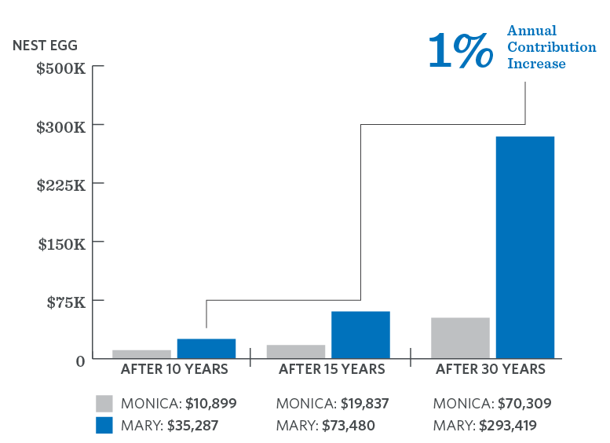
AUTO-INCREASE
choose how much to increase your contribution rate and how often
Monica and Mary
Both earn $30,000 salary, receive 3% raise each year, start saving at 35, earn 6% annually
Monica saves 2% annually
Mary starts saving 2%, raises contributions by 1% until 10%, and saves 10% for next 22 years
Illustration is hypothetical and not meant to reflect the return of any specific investment. You should evaluate your ability to continue the auto-increase service in the event of a prolonged market decline, unexpected expenses, or an unforeseeable emergency.
Notes:
[OPTIONAL – CLIENT-SPECIFIC (If plan has auto-increase]
Your employer’s retirement plan has an easy way to put more into your account every year. It’s called auto-increase. This tool lets you schedule automatic annual increases to your contributions, on the date you choose, by the amount you choose. This can get you to your optimal contribution rate gradually — without you having to remember to manually update it. For example – set it to increase by 1% on your birthday every year. It’s an automatic birthday gift to the future you!
Let’s look at hypothetical twins who did almost everything the same. They worked at the same company, earned the same salary ($30,000 a year), and started contributing to the same retirement plan at age 35. The only difference? How they managed their contribution rates. Monica contributed 2% of her pay each year, her salary rose 3% a year, and her investments earned 6% annually until retirement.
Mary followed the same route, but she raised her contribution rate by 1% each year until it reached 10%. Then she kept contributing 10% for the next 22 years, until retirement. When the twins turned 65, they compared notes on their retirement accounts. Monica had a nest egg of $70,309, while Mary had $293,419 — nearly triple her sister’s total. Mary told Monica she hardly noticed the difference in her take-home pay when she raised her contribution percentage each year by 1%. But the result was impossible to overlook.
You can turn the service on (or off) any time at [CLIENT URL].

Slide 24
PENSION PERKS
YOUR EMPLOYER PROVIDES A PENSION PLAN
You may have noticed a pension plan balance when you logged in to your account.
Also known as a defined benefit plan
No action on part of employees
Employer contributes money and selects investments
Guaranteed payment from the plan upon retirement
Notes:
[OPTIONAL – CLIENT-SPECIFIC (If there is a pension plan]
You may have noticed a pension plan balance when you logged in to your account.
Pension plans, also known as defined benefit plans, are provided by some employers without employees having to take any action
Your employer contributes money to the pension plan and invests it in funds of their choosing. Employees cannot contribute their own money to the pension plan, nor can they select the investments.
Upon retirement, you will receive a guaranteed payment from your pension

Slide 25
HEALTH SAVINGS ACCOUNT (HSA)
YOUR EMPLOYER OFFERS THE TRANSAMERICA HSA
If you’re enrolled in a high-deductible health plan, you can choose to contribute to an HSA.
What are the benefits?
Triple tax advantage
Always yours to keep
Convenient
Potential retirement boost
CREATE OR ACESS YOUR HSA BY LOGGING IN AT
secure2.transamerica.com/login
Notes:
[OPTIONAL – CLIENT-SPECIFIC (If the sponsor offers an HSA]
Your employer offers a health savings account, commonly known as an H-S-A, which can be a great way to pay for qualified medical expenses.
What are the benefits of an H-S-A?
Triple tax advantage: You pay no federal income tax on H-S-A contributions, current investment growth, or withdrawals when the money is used to pay qualifying medical expenses
Always yours to keep: Unlike a healthcare flexible spending account (F-S-A), H-S-A balances remain yours each year with no use-it-or-lose-it requirement. And because your H-S-A is an individual account, you can still use it if you change employers.
Convenience: Your H-S-A debit card can be used for payment, with no requirement to immediately verify the expense (we recommend keeping receipts for tax purposes). And you can view your retirement plan and H-S-A account balances through secure-two-dot-transamerica-dot-com-slash-login.
Potential retirement boost: If you don’t need to access savings to cover current health-related expenses, an H-S-A can act as a highly tax-favored retirement account, which can also be invested and potentially grow.
If you’re in a high-deductible insurance plan, you can enroll in a health savings account when you log in through secure-two-dot-transamerica-dot-com-slash-login. You can ask your employer for information about your organization’s open enrollment period.

Slide 26
INVESTMENT OPTIONS AND SERVICES
Notes:
Being in the plan is a critical first step – but a comprehensive retirement strategy also means deciding how your contributions will be invested. Transamerica offers an array of choices, from do-it-yourself investment selection to automated tools and services. Let’s take a look at the options available with your employer plan.

Slide 27
INVESTMENT OPTIONS
Do it yourself
Automated investment services
Build a portfolio using choices from the plan’s investment lineup
[Schwab Personal Choice Retirement Account®]
[PortfolioXpress®]
Target date funds
Asset allocation funds
[Custom model portfolios]
[Managed Advice®] [Advisor Managed Advice℠]
Log in at transamerica.com/portal to learn more about these options
Notes:
[CLIENT SPECIFIC – FA will want to edit variable content to match plan]
The first thing you’ll want to decide is the type of investor you are. Are you hands-on and want to research your choices and investment options yourself? Or are you hands-off and would like some professional help?
For the hands-on investors, every plan offers the do-it-yourself approach. Transamerica has many resources to help you make informed decisions. You can find more information about your investment choices at transamerica-dot-com-slash-portal.
If you prefer some assistance or want the plan to take care of selecting investments for you, your plan may allow you to choose from one of our automated investment services. These services range from target date funds to professionally managed services, for a fee. To see the options available to you, check your plan summary document or log in to your account at transamerica-dot-com-slash-portal and go to the Investments tab along the top navigation. Alternatively, you can schedule an appointment with me, and we can walk through your options.

Slide 28
PORTFOLIOXPRESS ®
Establish your investment portfolio with PORTFOLIOXPRESS
Automated asset allocation
Automated periodic re-balancing
Becomes more conservative over time
See important disclosures on the following slide
Notes:
[OPTIONAL – CLIENT-SPECIFIC (If plan offers PortfolioXpress®)]
PortfolioXpress® is an asset allocation and rebalancing service. It uses investments in the plan’s fund lineup to create a diversified investment mix based on your risk tolerance and anticipated retirement year. Offered [at no additional cost] [for a fee of [xx percent annually], this service automatically rebalances your account periodically and becomes more conservative as you get closer to retirement. You can track your progress online and discontinue the service at any time.

Slide 29
PORTFOLIOXPRESS ® DISCLOSURES
PortfolioXpress® is a registered service mark of Transamerica. PortfolioXpress® presents a series of asset allocation models up to and through a designated retirement year. You are solely responsible for choosing the retirement year and risk preference (if applicable). By subscribing to the service, you agree to each of the asset allocation mixes and automated rebalancing transactions that will take place over time within your account as you approach the selected retirement year. If you sign up, you should carefully review the service agreement for additional information regarding other terms and conditions that may apply to this service. PortfolioXpress® is designed as investment education. Transamerica or its affiliates do not provide investment advice to PortfolioXpress® nor does Transamerica act as a plan fiduciary. Retirement date portfolios are subject to the same risks as the underlying asset classes in which they invest. The higher the portfolio's allocation is to stocks, the greater the risk. The principal value of the portfolio is not guaranteed at any time, including at and after the target date. Diversification does not guarantee against loss in a falling market.
Notes:
[OPTIONAL – CLIENT-SPECIFIC (Include if previous PX slide is used)]

Slide 30
TARGET DATE FUNDS
THE DESCRIPTION IS IN THE NAME
Designed for “target” retirement year
More aggressive early
More conservative as you near retirement
Target date funds generally invest in a mix of stocks, bonds, cash equivalents, and potentially other assets, either directly or via underlying investments, and may be subject to all the risks of these assets. The investment allocations become more conservative over time: The percentage of assets allocated to stocks will decrease while the percentage allocated to bonds will increase as the target date approaches. The higher the allocation is to stocks, the greater the risk. The investment option’s principal value is never guaranteed, including at and after the target date. The glide path above is illustrative and does not represent a specific asset allocation at any given time.
Notes:
[OPTIONAL – CLIENT-SPECIFIC (If plan offers target date funds)]
You’ve probably heard of target date funds – and if you haven’t, don’t worry. The explanation is pretty much in the name.
Target date funds allow you to pick one fund with the target date closest to the year you want to retire. The investments within the fund generally cover a broad mix of stocks and bonds. The fund gradually adjusts its investment strategy to become more conservative as the target date approaches. This is designed to protect against market losses as you near retirement.
As with all investments, target date funds aren’t foolproof. They’re subject to the same risks as the assets they hold. In general, the larger the stake in stocks, the greater the risk. That may not be a big problem if your target is decades away — hopefully, you’ll have time to recoup losses and take advantage of any market upswings between now and then. But if you expect to retire in just a few years, an ill-timed, across-the-board market crash could put a crimp in your plans.

Slide 31
ASSET ALLOCATION FUNDS
Diversified funds
Stated ratio of equities and fixed-income investments
Allocations do not become more conservative over time
Asset allocation funds invest in a mix of stocks, bonds, cash equivalents, and potentially other types of assets, either directly or via underlying investments, and are generally considered diversified investment choices. Allocation funds may be subject to all of the risks of the assets in which they invest. The higher the fund’s allocation to stocks, the greater the risk. Asset allocation and diversification do not assure better performance, cannot eliminate the risk of investment losses, and do not protect against an overall declining market.
Notes:
[OPTIONAL – CLIENT-SPECIFIC (If plan offers asset allocation funds)]
Asset allocation funds are diversified funds with unit values, managed by an investment manager, or series of investment managers, which hold a stated ratio (or range of ratios) of equity and fixed income securities associated with a specific risk description. These funds are static in allocation, and do not become more conservative over time.

Slide 32
CUSTOM MODEL PORTFOLIOS
Customized allocations
Finding a risk comfort zone
Rebalancing to reflect investment goals
When considering a custom portfolio, first think about your personal circumstances, market outlook, risk tolerance, and the potential universe of appropriate investments. If you subscribe to the service, your account will be rebalanced to the portfolio option you select. From time to time, funds may be added to or removed from the custom portfolio mixes, or changes may occur to the portfolios’ target investment allocations. The custom model portfolios are subject to the same risks as the underlying assets in which they invest. The higher the portfolio's allocation to stocks, the greater the risk. The portfolio's principal value is never guaranteed. The maintenance of these portfolios is the responsibility of your plan’s sponsor or advisor. Transamerica Retirement Solutions does not provide advice to custom portfolios.
Notes:
[OPTIONAL – CLIENT-SPECIFIC (If plan offers custom model portfolios)]
Everyone here has a different approach to investing. Some of us don’t mind taking a little more risk, while others might play it safe – and others are somewhere in between. There’s nothing wrong with any of those preferences.
Your plan can help you find an investing comfort zone with Custom Model Portfolios. [ABC company] has created different investment portfolios designed to offer diversification in one easy step. Based on your risk tolerance, you can pick a portfolio made up of investments already in your plan’s fund lineup.
Your current and future balances will be invested according to the portfolio’s allocations. Each Model Portfolio is tailored to a specific investment goal and risk profile — from conservative to aggressive — and will be periodically rebalanced to help you stay on course with your investment strategy.

Slide 33
[Managed advice ®] [Advisor Managed Advice ℠]
A DETAILED RETIREMENT STRATEGY, MADE JUST FOR YOU.
Personalized investment portfolio
Contribution rate recommendation
For more information, call 844-622-2133
Outside account aggregation
Retirement spending plan
Target retirement age
Social Security integration
See important disclosures on the following slide and at the end of this presentation.
Notes:
[OPTIONAL – CLIENT-SPECIFIC (If plan offers (Managed Advice®)(Advisor Managed Advice℠)]
Another service that Transamerica offers can take you from just being “in the plan” to having a strong foundation for a holistic retirement strategy. What do I mean by that?
Contributing money to the [Client Name] retirement plan is a great first step for a strong financial future. But there are still several questions to consider:
--How should you invest your account?
--How much should you contribute from your paycheck to give you the best chance of reaching your retirement goals?
--And once you actually retire – how will you withdraw your money in such a way so that it lasts throughout your retirement?
[Managed Advice][Advisor Managed Advice] is an automated investment service that can give you answers to all these questions and more. It provides you with a personalized investment portfolio, a specific recommendation for how much you should be contributing to the plan, and a spend-down strategy for retirement. It also considers your potential Social Security benefits and any additional retirement accounts you may have outside your workplace retirement plan.

Slide 34
MANAGED ADVICE ® DISCLOSURES
Transamerica's Advice Services includes Managed Advice® and Advisor Managed Advice℠. The Managed Advice® service is available within employer-sponsored plans and individual retirement accounts (“IRAs”) and is offered through Transamerica Retirement Advisors, LLC (“TRA”), an SEC-registered investment advisor. In a retirement plan, the investment options used in Managed Advice® are selected by your plan sponsor/plan fiduciary. In an IRA, the investment options used in Managed Advice® have been selected by an independent, third-party registered investment advisor, which acts as a fiduciary for lineup selection. The Advisor Managed Advice℠ service is offered through your retirement plan's third-party registered investment advisor and TRA, and investment options are selected by your plan sponsor/plan fiduciary. Neither TRA nor Advice Services provide advice for, recommend allocations of, or manage individual stocks, self-directed brokerage accounts, or employer-directed monies, even if they are available for investment in a plan or account. Transamerica Retirement Solutions and TRA are affiliated companies. Morningstar Investment Management, LLC®, a wholly-owned subsidiary of Morningstar Inc. is an SEC-registered investment advisor that serves as an independent financial expert and provides the underlying investment advice methodology for Advice Services. Neither Morningstar nor your plan's third-party registered investment adviser (as applicable) is affiliated with any Transamerica companies. Please see the Advice Services agreement as applicable for more information on the terms and conditions that apply, as well as the information provided to you in Form ADV Part 2A. Investment return and principal value will fluctuate with market conditions, and you may lose money.
Notes:
[OPTIONAL – CLIENT-SPECIFIC (Include if previous MA slide is used)]

Slide 35
SECUREPATH FOR LIfe ®
Designed for participants age 50+
Guaranteed withdrawals for life (if excess withdrawals reduce the income base to zero, the benefit will terminate)
Protection against market volatility
An investment option that matches an underlying target date fund
You cannot transfer among other investment options without terminating benefit
Current costs range from 0.13% – 0.15% for underlying fund charges, plus the 1.45% annual expenses for insurance features and administration
Guarantees are subject to the claims-paying ability of the issuing insurance company. See important disclosures on the following slide.
Notes:
[OPTIONAL – CLIENT-SPECIFIC (if plan offers SecurePath for Life®)]
For participants age 50 or older, you may want to consider SecurePath for Life. It’s an investment option designed to provide guaranteed income for life … protect income against market volatility … and provide diversification and potential growth for the long run.
In short, SecurePath for Life combines the simplicity of a diversified target date fund with the unique features of a variable annuity contract. It enables people to have protection against market drops and still take advantage of potential market gains.
You will be assigned an investment option with an underlying target date fund that closely matches the date you'll turn 65. You will not be permitted to transfer among other investment options without terminating the benefit.
Transamerica is committed to providing people with an income they’ll never outlive, and SecurePath for Life is one example of that commitment.

Slide 36
SECUREPATH FOR LIFE ® DISCLOSURES
SecurePath for Life® consists of a group variable annuity contract, which offers certain guaranteed lifetime withdrawal benefits to participants. Although SecurePath for Life® provides a guaranteed income base as well as a guaranteed income amount consisting of a guaranteed lifetime withdrawal benefit, the investment options available under the product are variable investments and may lose value. Certain withdrawals will reduce a participant’s income base, and therefore the guaranteed income amount. A plan sponsor may exercise certain rights under the group variable annuity contract that may terminate the guaranteed lifetime withdrawal benefits available to participants, including termination of the contract, termination of the plan, or the transfer of the assets left under the contract to another investment fund. Guarantees are subject to the terms and conditions set forth in the contract and the prospectus. By objectively describing the features of the SecurePath for Life® product without naming the specific underlying funds of the product, Transamerica does not intend to provide an investment recommendation.
Group annuity contracts are issued by Transamerica Life Insurance Company (TLIC), 4333 Edgewood Road, NE, Cedar Rapids, Iowa 52499, which is licensed and offers products in all states, except New York. Guarantees of withdrawals provided under SecurePath for Life® are supported by TLIC’s general account and are based on the claims-paying ability of TLIC. Group annuity contracts issued in New York are issued by Transamerica Financial Life Insurance Company (TFLIC), 440 Mamaroneck Avenue, Harrison, NY 10528, which is licensed in New York. Guarantees of withdrawals provided under SecurePath for Life® are supported by TFLIC’s general account and are contingent on the claims-paying ability of TFLIC. Product features and availability may differ by state. PSPL10TLICNC and PSPL09TFLICNC.
Notes:
[OPTIONAL – CLIENT-SPECIFIC ([OPTIONAL – CLIENT-SPECIFIC (Include if previous SecurePath for Life slide is used)]

Slide 37
DO-it-yourself approach
CONSIDER THE FOLLOWING:
Are you comfortable with investing principles, such as diversification, asset allocation, and risk?
Will you give yourself time to monitor and rebalance your portfolio?
Transamerica has resources to help you make informed decisions.
Visit: transamerica.com/portal/[url]
All investments involve risk, including loss of principal, and there is no guarantee of profits. Investors should carefully consider their objectives, risk tolerance, and time horizon before investing. There is no assurance that any investment will meet its stated objective. Please contact your financial professional if you have questions.
Notes:
If you prefer to select your own investments, you can. Before you do, consider the following:
Are you comfortable with investing principles, such as diversification, asset allocation, and risk?
Will you give yourself time to monitor and rebalance your portfolio?
If you choose to create your own portfolio, Transamerica can provide resources and guidance to help you make informed decisions. Visit your plan’s website, [Transamerica.com/portal[/url]], [or come see me after this presentation].

Slide 38
SCHWAB PERSONAL CHOICE RETIREMENT ACCOUNT®
8,500+
630+
mutual funds
fund families
Knowledgeable investors
Comfortable with the additional risk associated with making investment decisions
Willing to assume any additional trading and maintenance costs that may apply
Schwab Personal Choice Retirement Account® (PCRA) is not a fund but rather a participant self-directed brokerage account maintained at Charles Schwab & Co., Inc. Participants must individually apply for PCRA and are solely responsible for their fund selections made under the PCRA. Commissions and transaction fees may apply to fund trades placed outside of the Schwab Mutual Fund OneSource® program or trades on other investment vehicles available through Schwab. An annual fee of $50 will be applied by Transamerica Retirement Solutions if you invest in the Schwab PCRA. Securities purchased through the PCRA are available through Charles Schwab & Co. Inc., (Member SIPC). Charles Schwab & Co., Inc. is not affiliated with Transamerica.
Notes:
[OPTIONAL – CLIENT-SPECIFIC (If plan offers PCRA)
A Schwab Personal Choice Retirement Account® (PCRA) provides investment flexibility, in part because it lets you invest in your retirement plan with the freedom of a brokerage account. The account offers more than 8,500 mutual funds and more than 600 families of funds.
If you're a knowledgeable investor who understands the risks that can come with making investment selections – and who's committed to staying invested for the long-term – this could be an appropriate option for you.

Slide 39
Investment options and services:
Log in to learn more about these available options:
[PortfolioXpress]
[Target Date Funds]
[Asset Allocation Funds]
[Custom Model Portfolios]
[Managed Advice] [Advisor Managed Advice]
[SecurePath for Life]
Do-It-Yourself Investment Selection
[Schwab Personal Choice Retirement Account]
Notes:
[CLIENT-SPECIFIC (FA: delete bullets on slide and script notes as needed)]
To re-cap – these are the investment options and services available within your plan:
[PortfolioXpress®]
[Target Date Funds]
[Asset Allocation Funds]
[Custom Model Portfolios]
[Managed Advice®][Advisor Managed Advice℠]
[SecurePath for Life®]
Do-It-Yourself Investment Selection
[Schwab Personal Choice Retirement Account®]

Slide 40
READY, SET, Enroll
Notes:
We’ve covered the importance of saving and the investment options available. Now let’s talk about how to enroll in your retirement plan.

Slide 41
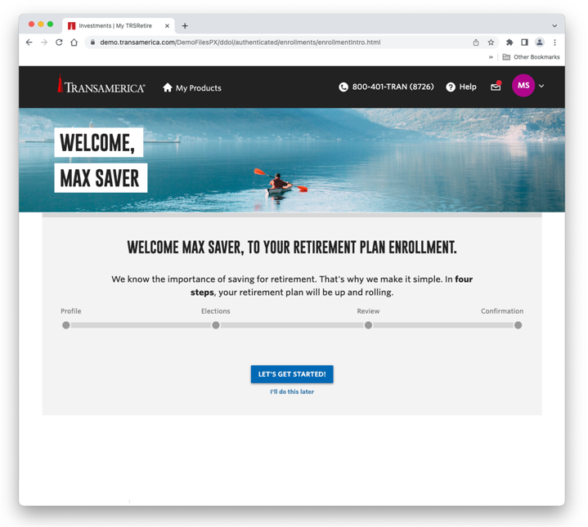
ENROLLMENT IS EASY!
FOLLOW THESE STEPS :
Visit secure2.transamerica.com/login
Click Create an Account
Provide personal information and answer a few questions to verify your identity
Upon completion, you will receive a security validation code via email, then you can select and answer security questions to create your account
Log in to your account with your username and password, then click View Details next to your retirement plan
Click Let’s Get Started
Create your profile
Visit: secure2.transamerica.com/login
Notes:
To begin, you will need to create your account online. This is the first step in making your account secure. Visit secure-2-dot-transamerica-dot-com-slash-login and click Create an Account.
Choose individual, then retirement plans. Next, answer the security questions and create your username and password. Use strong passwords — and DO NOT reuse passwords for multiple accounts. We suggest creating unique passwords that are at least eight characters long and use combinations of lower and upper-case letters with numbers and/or special characters. Set up multi-factor authentication, also known as two-factor and two-step authentication. This helps minimize risk by adding a step to verify your identity, rather than relying on your username and password alone.
Next, you will come to a page that says, “My Transamerica Plans.” Click the blue VIEW DETAILS button next to your plan. You will be asked to create a profile. Some of the information will pre-populate, then you’ll complete the rest.
The next screen will welcome you to your Retirement Plan enrollment. Simply click “Let’s get Started.”

Slide 42
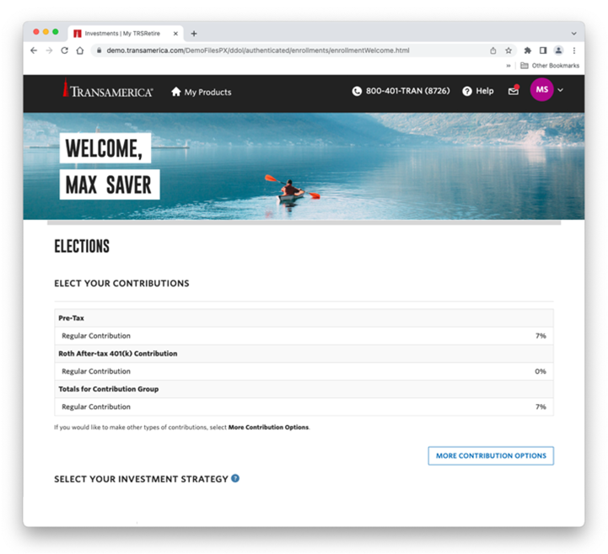
ENTER YOUR CONTRIBUTION ELECTIONS
ENTER THE AMOUNTS YOU WISH TO SAVE:
Click More Contribution Options
Enter your contribution amount
If applicable, enter Roth contribution amount
If applicable, enter auto-increase amount
Click Continue`
Notes:
Now you’ll see the Elections page. First click the blue “More Contribution Options” button. Here you will enter your contribution amount, and, if Roth is available on your plan, you can choose a Roth amount. Keep in mind, you can do both a pretax contribution and a Roth contribution. You can use the calculator provided there to see the amount that will be deducted from every paycheck. Enter your auto-increase amount, if available. Click the blue “Next” button.

Slide 43
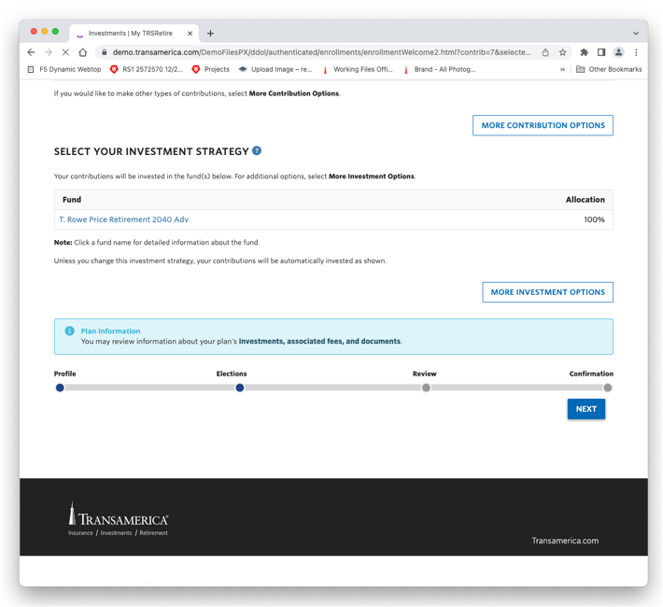
ENTER YOUR INVESTMENT OPTIONS
NOW CHOOSE YOUR INVESTMENT OPTIONS:
Click More Investment Options
If applicable, select a turn-key investment
Or if you prefer, choose to Do it Yourself
Click Next then Save
Read the agreement
Click Agree and Continue
Notes:
You’ll now be back on your Elections page. Click the blue “More Investment Options” button and choose whether you want to pick the funds yourself or use an automated option, if available. Click the blue “Next” button. You’re now back on the Elections page. Click the blue “Next” button. On the “Review and Save” page, ensure your elections are correct and click “Submit.” Read the box and click “Agree and Continue.” [Please note, if you chose Managed Advice or PortfolioXpress, there will be a few more steps. Please follow the online instructions.]
With that complete, we have one more step…

Slide 44
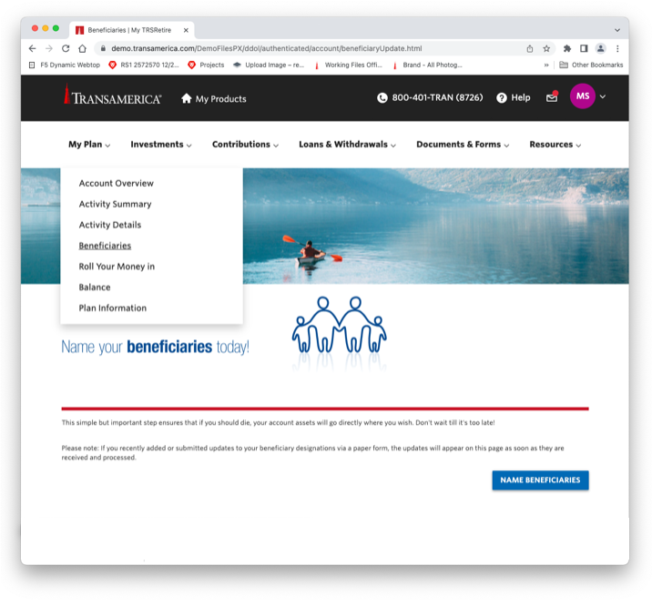
Protect your loved ones
ENTER YOUR BENEFICIARY INFORMATION:
In the blue box, click Name Beneficiaries
Click Add/Update at the bottom right
Enter primary beneficiary information
Enter contingent beneficiary information, if desired
Review all information you entered
Click Continue
Confirm the information is correct – click Submit
Read the agreement
Click Accept and Continue
Congratulations! You’re enrolled in your retirement plan.
Notes:
Now you need to enter your beneficiary information. In the blue box, click the Name Beneficiaries. On the next screen, click the blue Add/Update button at the bottom right and enter the contact information for the person, or people, you would like the money in your account to go to when you pass away. You’ll need to designate a primary beneficiary, and then you can designate a contingent beneficiary, if desired. Keep in mind, if you’re married and designate someone other than your spouse as a primary beneficiary, spousal consent may be required.
Once entered, click the blue Continue button, review the information, and click Submit. Read the agreement, then click Accept and Continue.
Congratulations! You’re now enrolled in your retirement plan and have easy and secure access to your account.
Whether you’re at home, on the go, or at the office, you can access your retirement account on your computer, laptop, tablet, or on your phone. Visit transamerica-dot-com-slash-portal[/url] or use the Transamerica Retirement app. You can find the app on the Apple store or Google Play.
Now that you’re enrolled, how do you monitor your retirement strategy to see whether you’re on track to meet your goals?

Slide 45
YOUR RETIREMENT OUTLOOK ®
Notes:
To see if your retirement strategy is working, we’re going to cover one last thing today.
Transamerica has created a simple way to know how you’re doing and has provided easy ways to help you improve your chances of securing a fully funded retirement. It’s called Your Retirement Outlook.

Slide 46
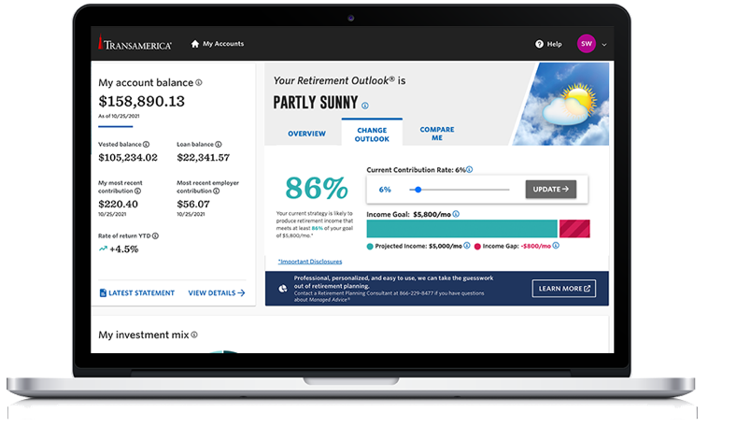
YOUR RETIREMENT OUTLOOK ®
Important: The projections or other information generated by the engine (which produces Your Retirement Outlook®) regarding the likelihood of various investment outcomes are hypothetical, do not reflect actual investment results, and are not guarantees of future results. Results derived from the tool may vary with each use and over time. Please see the end of this presentation for more information regarding the criteria and methodology used, the engine’s limitations and key assumptions, and other important information.
Your personalized retirement analysis
Notes:
Your Retirement Outlook uses weather icons to illustrate your progress toward your retirement income goal.
A rainy icon means your current strategy is likely to generate less than 65 percent of your goal, while a sunny icon means your strategy is likely to generate at least 95 percent of your goal.
The “goal” we’re talking about is 80 percent of your current salary. You can log in to your account and adjust the default setting if 80 percent doesn’t sound right for you.
The more information you provide in your profile, the more accurate Your Retirement Outlook will be. You can add other retirement or savings accounts or any other sources of income you expect to have in retirement, like an inheritance.
This tool can be found under the Are You OnTrack tab when you log in to your account. There is also a Compare Me tab you can explore to see how you stack up against your peers regarding your retirement strategy.

Slide 47
AFTER ENROLLING, OPTIMIZE YOUR PLAN
Review Your Retirement Outlook periodically
Adjust contribution rates
Monitor investments
Periodically rebalance
Review strategy after major life events
Update beneficiaries
Notes:
Make sure you log in to your account periodically at transamerica.com/portal[/url] to see how you’re doing. You can update your information via the drop-down menu under your initials at the top right of the screen. Along the top of the screen, you have a menu that includes My Plan, Investments, Contributions, Loans & Withdrawals, Documents & Forms, and Resources. These drop-down menus make it easy to navigate around your account and manage your retirement strategy with confidence.
Should you experience a major life event, such as a marriage, divorce, a child, or a death, you’ll want to update your beneficiaries under the My Plan tab. It’s important to keep that information current. If you have any questions or need assistance in optimizing your retirement plan, please schedule an appointment with me at a time convenient for you.
Some of you may be thinking, I’d like to do this with my old retirement accounts. Can I optimize my plan with those?

Slide 48
CONSIDER combining accounts
FOUR OPTIONS:
Leave money in old account
Roll it into new plan with Transamerica
Roll it into an IRA (with Transamerica or another provider)
Cash it out – 20% mandatory federal tax withholding, plus 10% penalty tax if under age 59½
BENEFITS OF COMBINING RETIREMENT ACCOUNTS:
Save time by streamlining how you track and manage your savings
Confidence your investments are aligned with your goals
Identify ways to improve your retirement readiness
Review the fees and expenses you pay, including any charges associated with transferring your account, to see if rolling over into an IRA or consolidating your accounts could help reduce your costs. Employer-sponsored retirement plans may have features that you may find beneficial such as access to institutional funds, fiduciary-selected investments, and other ERISA protections not afforded other investors. In deciding whether to do a transfer from a retirement plan, be sure to consider whether the asset transfer changes any features or benefits that may be important to you.
Notes:
[NOTES FOR CLIENT-SPECIFIC VERSION]
Well, to help you decide what to do with those previous accounts, you have several options.
You can leave the money in the old account; roll it into your new plan with Transamerica; roll it into an IRA; or cash it out. Keep in mind, if you decide to cash out, you’ll pay ordinary income tax on the distribution – and if you’re under the age of 59½, you may be subject to a ten percent IRS early withdrawal penalty.
Each option has potential advantages and disadvantages, and you should carefully review what they are. If you want to talk through the pros and cons of each option, please reach out to me, and we can take a closer look.
By accounting for these old retirement accounts, it will provide a more complete forecast of your retirement strategy in Your Retirement Outlook.

Slide 49
A LIFETIME OF FINANCIAL WELLNESS
You’ll have financial questions throughout your career. No matter what's next on your radar, Transamerica can help.
Notes:
One parting thought: Whenever you’re faced with financial decisions, remember that the choices you make today may impact your ability to retire when and how you want. Transamerica has many resources to help you make smart financial decisions along your journey to retirement. They want to help you have a strong financial foundation, because they understand without that, retirement planning can easily fall off your radar. So even if retirement is 10, 20, or 30 years away, Transamerica is there to help you today, wherever you are on your journey.
Let’s take a look at several resources.

Slide 50
RETIREMENT RESOURCES
transamerica.com/portal[/url]
Your Retirement Outlook®
Personal finance calculators
Fund information
transamerica.com/portal/financial-wellness
Personalized learning path
transamerica.com/webinars
Expand your knowledge — live, or recorded webinars
Notes:
[NOTES FOR CLIENT-SPECIFIC VERSION]
At transamerica-dot-com-slash-portal, you’ll find several links to assist you, such as financial calculators and information on available funds.
If you would like to learn more about investing and other financial topics, visit transamerica-dot-com-slash-portal-slash-financial-hyphen-wellness, where you can personalize your learning path.
You can also visit transamerica-dot-com-slash-webinars, where you can attend live or pre-recorded webinars designed to expand your knowledge about a variety of financial topics.
Of course, you can also schedule an appointment with me to assist you in your retirement planning.

Slide 51
WE’re here to help
Get in touch
Make an appointment
[FA NAME]
[RPC, copy in individual QR code link here]
[Insert
Headshot
Here]
[FA email address]
[FA phone number]
[On-site location if available]
Transamerica is not affiliated with [advisor firm]. [Add advisor firm disclosure here.]
Notes:
CLIENT-SPECIFIC PRESENTATION
FA: fill in whichever contact methods you prefer and delete sections you do not need.
The bottom line is Transamerica and I are available to help. Whether you need help enrolling or navigating the website, you want to discuss your retirement plan and how to optimize your account, or you just have some financial questions and you’re not sure where to go to find answers, give Transamerica a call at [xxx-xxx-xxxx] or schedule an appointment with me. Your retirement is made up of all the individual choices and decisions you’ve made throughout your life. Let us help you stay on course for a brighter future.
Here’s my contact information.
Thank you for joining me today.

Slide 52
DISCLOSURES
About Probability Illustrations, Limitations, and Key Assumptions
The probability illustrations generated from the engine are based on “Monte Carlo” simulations of 500 possible investment scenarios for a given time period and assume a range of possible returns. The illustrations are generated according to models developed by Morningstar Investment Management LLC, a leading independent provider of asset allocation, manager selection, and portfolio construction. The Your Retirement Outlook® graphic reflects the difference between the model’s estimated annual income (which corresponds to a 70% probability level of income in the investment scenarios simulated) and your annual income goal.
The probability illustrations, including the Your Retirement Outlook® graphic, estimated retirement income graphic, sources of your retirement income chart, and income planning spend down illustration generated from the engine are based on “Monte Carlo” simulations of 500 possible investment scenarios for a given time period and assume a range of possible returns. The “About Probability Illustrations, Limitations, and Key Assumptions” apply to the OnTrack® tool and the Advice Services, which includes Managed Advice® (offered in plans and IRAs) and Advisor Managed AdviceSM. The illustrations are generated according to models developed by Morningstar Investment Management LLC, a leading independent provider of asset allocation, manager selection, and portfolio construction. The Your Retirement Outlook® graphic reflects the difference between the model's estimated annual income (which corresponds to a 70% probability level of income in the investment scenarios simulated) and your annual income goal.
Notes:
Read slide

Slide 53
DISCLOSURES
About Probability Illustrations, Limitations, and Key Assumptions (continued)
Lower Risk/ Volatility
Asset Class Cash Alternatives Short Term Bonds Aggregate Bonds Foreign Bonds Direct Real Estate High Yield Bonds TIPS Long Term Bonds Large Cap Value Equity Large Cap Equity Mid Cap Value Equity Mid Cap Equity International Equity Commodities Mid / Small Cap Value Equity Large Cap Growth Equity Mid / Small Cap Equity Small Cap Value Equity Small Cap Equity Mid Cap Growth Equity Mid / Small Cap Growth Equity REITs Small Cap Growth Equity Emerging Markets Equity | Benchmark BofA ML US Treasury Bill 3 Month USD BarCap US Govt/Credit 1-3 Yr TR USD Barclays Capital US Agg Bond TR Barclays Global Aggregate Ex USD TR NCREIF Transaction Based Index Barclays Capital US Corporate High Yield TR Barclays Capital Global Inflation Linked US TIPS TR Barclays Capital US Govt/Credit Long TR Russell 1000 Value TR Russell 1000 TR Russell Mid Cap Value TR Russell Mid Cap TR MSCI EAFE GR Bloomberg Commodity TR Russell 2500 Value TR Russell 1000 Growth TR Russell 2500 TR Russell 2000 Value TR Russell 2000 TR Russell Mid Cap Growth TR Russell 2500 Growth TR FTSE NAREIT Equity REITs TR Russell 2000 Growth TR MSCI EM GR
Higher Risk/ Volatility
Notes:
Read slide

Slide 54
DISCLOSURES
The probability illustrations assume both retirement at the age at which you qualify for full Social Security benefits and an annual retirement income goal of 80% of your projected final working salary. These assumptions are adjustable by you or by your employer if you are in an employer-sponsored retirement plan. Social Security estimates are based on the Social Security Administration methodology and your current salary. If you have indicated within your Retirement Profile, Advice Services Profile, or your Managed Advice Profile that you are retired, you are required to input your actual Social Security benefit amount provided by the Social Security Administration. The probability illustrations also assume a consistent contribution percentage, if applicable, and asset allocation (no future changes or rebalancing unless you are subscribed to one of the Advice Services or a target date asset allocation service), annual inflation of approximately 2%, and annual salary increases (unless you are retired), based on a calculation that incorporates multiple factors including a salary growth curve and inflation. Mortality assumptions are based on the Society of Actuaries tables. In addition to all of the personal information you have input into your Retirement Profile, Advice Services Profile, or your Managed Advice Profile, and, if applicable, any retirement plan information that Transamerica's record keeping system maintains such as account balance, contribution rates, asset allocation and retirement plan information, the probability illustrations contemplate tax rates, retirement needs, social security, and future cash flows. The simulations model tax rules for most taxable and tax-deferred investment accounts. Tax rules are applied throughout the process, including required minimum distribution rules that apply to some tax-deferred accounts. Any withdrawals from tax-deferred sources may be assessed an early withdrawal penalty which is taken into consideration in these illustrations. The spend-down order of your accounts is determined by an algorithm and aims to optimize tax exposure (by generally exhausting taxable accounts first then tax-deferred accounts) and Social Security benefits. Your selected retirement year (and your spouse/ partner's retirement year as applicable) can vary the withdrawal sequence determined by the engine. The engine will avoid withdrawing from tax- deferred accounts, should you (and your spouse/partner as applicable) select a retirement age younger than 60 years old. If income is needed and no other sources of income exist, the engine will be forced to withdraw from tax-deferred accounts holding after-tax money and tax deferred accounts in the simulations, as needed. Estimated retirement income used in the probability illustrations are after-tax.
The models are subject to a number of limitations. Returns associated with market extremes may occur more frequently than assumed in the models. Some asset classes have relatively limited histories; for these classes the models use historical data for shorter time periods. The model does not consider other asset classes such as hedge funds or private equity, which may have characteristics similar or superior to those used in the model. Capital market assumptions are forecasts which involve known and unknown risks, uncertainties, and other factors which may cause the actual results to differ materially and/or substantially from any future results, performance, or achievements expressed or implied by those projections for any reason.
There is no guarantee that your income goal will be achieved or that the aggregate accumulated amount will ensure a specified annual retirement income. Results may vary with each use and over time.
Notes:
Read slide

Slide 55
DISCLOSURES
IMPORTANT: The projections or other information generated by the engine regarding the likelihood of various investment outcomes are hypothetical in nature, do not reflect actual investment results, and are not guarantees of future results. Moreover, even though the tool’s estimates are statistically sound based upon the simulations it runs, the tool cannot foresee or account for every possible scenario that may negatively impact your financial situation. Thus, you should monitor your account regularly and base your investment decisions on your time horizon, risk tolerance, and personal financial situation, as well as on the information in the prospectuses for investments you consider.
Transamerica has licensed the Morningstar® Wealth Forecasting EngineSM from Morningstar, Inc., which is used by Morningstar Investment Management LLC, a registered investment adviser and subsidiary of Morningstar, Inc, in the services it provides to participants. Morningstar and Morningstar Investment Management are not affiliated with Transamerica. The Morningstar name and logo are registered marks of Morningstar, Inc.
Securities offered by Transamerica Investors Securities Corporation (TISC), 440 Mamaroneck Avenue, Harrison, NY 10528. All Transamerica companies identified are affiliated but are not affiliated with your employer.
This material was prepared for general distribution. It is being provided for informational purposes only and should not be viewed as an investment recommendation. If you need advice regarding your particular investment needs, contact your financial professional.
Registered funds are available by prospectus only. Any mutual fund offered under the plan is distributed by that particular fund's associated fund family and its affiliated broker-dealer or other broker-dealers with effective selling agreements such as TISC. For more information on any registered fund, please call Transamerica Retirement Solutions at 800-755-5801 for a free summary prospectus (if available) and/or prospectus. You should consider the objectives, risks, charges, and expenses of an investment carefully before investing. The summary prospectus and prospectus contain this and other information. Read them carefully before you invest.
Health savings products and services offered through Transamerica Health Savings Solutions, LLC.
Transamerica is sponsoring financial education programs developed by EVERFI, an unaffiliated third party. Transamerica is not responsible for the content of the financial education program.
Notes:
Read slide

Slide 56
Thank you
RPC1 111436R5 V 12/23
© 2023 Transamerica Corporation. All Rights Reserved.
Notes:
Thank you.

