Slide 1
Work Breakdown Structure (WBS)
Outline Format Example

Slide 2
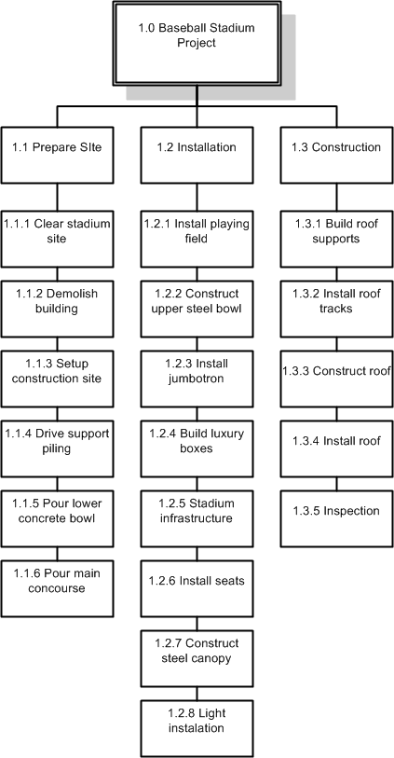
Work Breakdown Structure (WBS)
Graphical Format Example
(Level 0) (Name of Project)
(Level 1) (Major Task)
(Level 2) (Subtasks)

