Slide 1
Creating a Professional Presentation
Chamberlain College of Nursing
Notes:
An electronic presentation is a common mode of communication in today’s healthcare environment. As with any written assignment, be sure to proofread the slides for spelling and grammatical errors. Well-prepared electronic presentations can stimulate the discussion. Conversely, poorly developed slides can result in an audience that is disenfranchised and counting the moments until the presentation is completed (Bott & Leonhard, 2007).

Slide 2
Presentation Software
Assists in communicating information
Simplifies creation of visuals
Lets you add film clips, sound, movie-like
transitions, animation, and run-alone shows
Notes:
Whether you are working as a nurse educator, nurse executive, staff development educator, or a graduate student, it is important for the nurse of the 21st century to be proficient in creating a professional presentation (Pugsley, 2010). The most common method of providing an electronic presentation is via the use of PowerPoint from Microsoft®. An electronic presentation is a great visual aid to enhance the message, especially when film clips, graphics, sounds, and more are judiciously added to the presentation.

Slide 3
Getting Started
Create an outline of your content
Select a slide design
Notes:
As you prepare the presentation, be cognizant of the fact that nothing beats preparation and understanding of the content to be presented. Begin the creation of the presentation by determining the goals and objectives of the session and outline vital concepts to ensure that the slides are presented in a logical sequence (Bott & Leonhard, 2007; Pugsley, 2010).
Unless you are proficient in slide design, use slide designs provided by PowerPoint; choose one slide design and continue the design throughout the presentation.
Consider the target audience when selecting the theme for your presentation. For example, a group of artists may prefer a vibrant and animated presentation, while a conservative approach would be more appropriate for the Board of Directors (Bott & Leonhard, 2007).

Slide 4
Principles of Good Visual Construction
5–7 rule
- Limit 5–7 lines per slide
Limit words to 5–7 per line
Use sans-serif fonts
Contrast between background and text
Notes:
It is important to create a balance in the slide design:
Ensure that the font is large enough for the audience to read. Select a sans-serif font such as Arial versus Times New Roman to make the text more legible for the reader.
Present the key message (on the slide) as bulleted or numbered points and elaborate in the speaker notes (see Slide 6 for creation of speaker’s notes).
In addition, if there are large amounts of text on the slide, the reader will be detracted from the message while attempting to read the slide instead of listening to you (Pugsley, 2010).
Select a slide design that will provide a good contrast between the text and the background color of the slide, like white text on a blue background, or black text on a light-colored background (Pugsley, 2010).

Slide 5
Fonts & Comparison
Script at 12 point
Times New Roman at 12 points
Arial at 12 points
Script at 16 points
Times New Roman at 24 points
Arial at 32 points
Presentation Skills
Presentation Skills
Presentation Skills
Presentation Skills
Presentation Skills
Presentation Skills
Notes:
The purpose of this slide is to demonstrate the legibility of various fonts and sizes. Imagine sitting in a room attempting to read the size 12-point fonts; please note how especially difficult it is to read the size 12-point “Script” font.

Slide 6
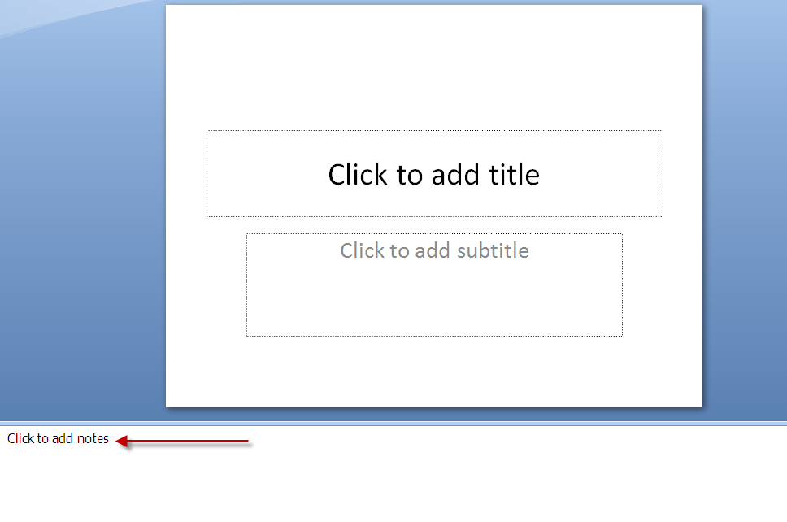
Speaker’s Notes
Notes:
As noted previously, the key concepts are to be presented as bulleted or numbered points on the slide. The additional information (for the speaker) is provided within the typed speaker notes, located under the slide in the Normal View.
The purpose of the Speaker Notes is to expand upon the idea and document what you want to say about the information on the slide. In addition, the Speaker’s Notes ensure that all key points are covered, and provide crucial information should the presentation be presented by multiple speakers, such as in a multi-facility system. Please note, the Speaker’s Notes should elaborate upon the key messages on the slide, and should not restate the contents of the slide.
To create Speaker’s Notes: Open your PowerPoint Presentation. The screen first opens in what is known as Normal View. Under the slide is a section that reads, Click here to add notes. Simply click and type.
Printing the Speaker’s Notes can be challenging. Do not use Quick Print as this will merely result in a copy of the entire slide versus the Notes Pages. To print the Speaker’s Notes, select Office → Print What → Select Notes Pages→ Grayscale → OK. The Notes Pages will provide you with a copy of the slide with the Speaker’s Notes located under the slide. For best quality of text, select grayscale versus pure black and white.

Slide 7
Special Effects: Embellish or Distract?
Sound
Graphics
Animation
Transition
Notes:
Be sure to follow the principles for slide design, such as be cautious to avoid the overuse of graphics, transition, and sound because they can detract from the message. In addition, too many graphics can greatly increase the size of the file and interfere with the time that it takes to download an online presentation. When choosing whether to insert a graphic, ask the following. Will the transitions or the graphics enhance the message or emphasize a key point? If not, do not insert the graphic or the transition simply for the sake of embellishing the slide. Do you see how the graphics in this slide do not add value to the message? Just as too many graphics are distracting, so is the use of too many transitions. Too many graphics, sounds, and transitions will detract from the message and are annoying during a lengthy presentation (to see an example of the poor use of sound and animation, view this slide in the Slide Show mode). You will quickly discover how the sound, if added to each slide, would be a major distraction from the message.
It is very easy to insert a graphic into a slide presentation, and images are readily available on the Web. One caveat is to be cognizant of copyright laws when adding graphics and media components to your presentation (Pugsley, 2010).

Slide 8
Putting it all Together
Plan for the unexpected
Use Notes
Don’t stand and read ALL notes
Make eye contact with audience
Practice, practice, practice!!!
Notes:
Prepare ahead of time by practicing your presentation to see if your timing is effective. Dress in a professional manner on the day of the presentation. Arrive early to determine that the equipment is available and functioning. Test the equipment before the audience arrives to familiarize yourself with its operation, and to ensure that the audience can view the slides and hear any audio that you have included. Place your notes in a location that allows you to look easily from the notes to the audience. Avoid staring too much at the projected slides because this gives the appearance that you are presenting to the screen. Instead, glance at each new slide to make sure it is the correct one, then direct your attention to the audience.
Plan for the unexpected. Make sure the presentation is backed up in several places. For example, use a flash drive, and e-mail the presentation to yourself. Create a plan to continue the presentation in the event that the equipment fails or is not available as anticipated.

Slide 9
References
Bott, E., & Leonhard, W. (2007). Using Microsoft office 2007: The only office book you need. Indianapolis, IN: Que Publishing.
Pugsley, L. (2010). Design an effective PowerPoint presentation. Education for Primary Care, 21, 51–53.
Notes:
Provide a list of references that are cited in the presentation. Consider ways to make the electronic file of the slides available after the presentation, perhaps by distributing to an e-mail list or posting on a website, especially if no handouts were distributed.

