Slide 1
NR447 Week 6 Assignment Fishbone and PDSA Quality Improvement Assignment Template
Directions: Use this template to complete the Week 6 Fishbone and PDSA Quality Improvement assignment as outlined in the assignment instructions in Canvas.
Click into the box below to add your name and date.
Click into each box where it says [Type Here] on the following slides.
Remove the words [Type Here] to insert your responses.
Name: [Type Here]
Date: [Type Here]

Slide 2
Problem to Examine in Root Cause Analysis (RCA):
[Type Here]
Rationale for Problem Selection:
[Type Here]
Brief Description of Literature Supporting the Need for Quality Improvement
(2-3 sentences, cite 1-2 sources):
[Type Here}
Notes:
Select a quality improvement (QI) problem you are familiar with. It may be a real problem you are currently encountering in practice or a past or future concern. Form a problem statement with that information. Some examples of problem statements include, but are not limited to:
The fall rate on the unit is above the benchmark.
The rate of ventilator-associated pneumonia (VAP) on the unit is above the benchmark.
The central line-associated bloodstream infection (CLABSI) rate is above the benchmark.
Admitted clients boarding in the Emergency Department are experiencing delays in care.
Healthcare providers are experiencing workplace violence with high injury rates.
Gather 1-2 scholarly sources of literature that document this problem in healthcare and provide evidence supporting the need for quality improvement.
Complete the sections in the template outlining the problem, the rationale for the selection of the problem, and the literature documenting the need for a solution.
List References on References Slide.

Slide 3
Realistic Target for QI Efforts
Yes:
No:
People
Environment
[Type Here]
[Type Here]
[Type Here]
[Type Here]
[Type Here]
[Type Here]
[Type Here]
[Type Here]
The Problem
[Type Here]
[Type Here]
[Type Here]
[Type Here]
[Type Here]
[Type Here]
[Type Here]
[Type Here]
[Type Here]
Method/Process
Equipment/Supplies
Notes:
Briefly describe the problem
Under each category (People, Environment, Method/Process, and Equipment/Supplies), list at least two contributing factors to the problem. The contributing factors may fall under more than one category.
See the example in the lesson for reference.
Make sure you have visually marked each contributing factor as realistic or unrealistic for improvement efforts using the visual designations in the upper right-hand corner of the slide (you can copy and paste the visual indicators).
See the example in the lesson.

Slide 4
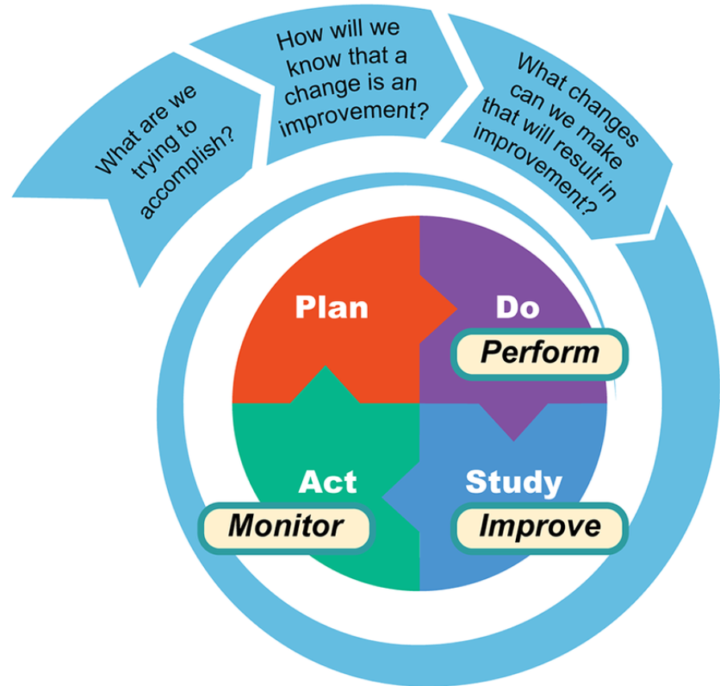
3. Write ONE SMART Goal for the PDSA Quality Improvement Project:
[Type Here]
4. Plan:
[Type Here]
5. Do:
[Type Here]
1. Select ONE Contributing Factor From Fishbone for PDSA:
[Type Here]
2. List 2-4 Interprofessional Stakeholders:
[Type Here]
[Type Here]
[Type Here]
[Type Here]
6. Study:
[Type Here]
7. Act:
[Type Here]
Notes:
Select one contributing factor from the fishbone diagram. This should be one of the realistic targets for improvement efforts that you indicated on your fishbone diagram.
List 2-4 interprofessional stakeholders involved in the project (delete any unused [Type Here] text).
Write one SMART goal for the PDSA Quality Improvement Project
Under the “Plan” phase, write a plan for the quality improvement project to meet the SMART goal. How will you meet your SMART goal? Describe your plan in 2-3 sentences.
Under the “Do” phase, assume you have completed the project. Briefly describe how the Plan was hypothetically implemented. What were the results? Include hypothetical data. Describe your implementation in 2-3 sentences using past tense.
Under the “Study” phase, assume you have completed the project. Briefly evaluate the data. Did your results demonstrate successful implementation? Identify whether the goal was met or not met. Describe your evaluation using 2-3 sentences using past tense.
Under the “Act” phase, assume you have completed the project. Briefly describe how to maintain the improvement or revise and repeat the PDSA process based on whether or not the goal was met. Describe your process in 2-3 sentences using past tense.
See the example in the lesson.

Slide 5
References (Hanging Indent Not Required)
[Type Here]
Notes:
Add references here for every cited scholarly source

